Slide 1










Fostering STEM education through
Meaningful Learning Environments
Shreya Gupta
Earth Observation Lab

Slide 2






About
Educational Framework
Freiraum 2023
Traditional STEM classrooms vs. innovative environments
Constructing optimal and sensible learning environments

Slide 3



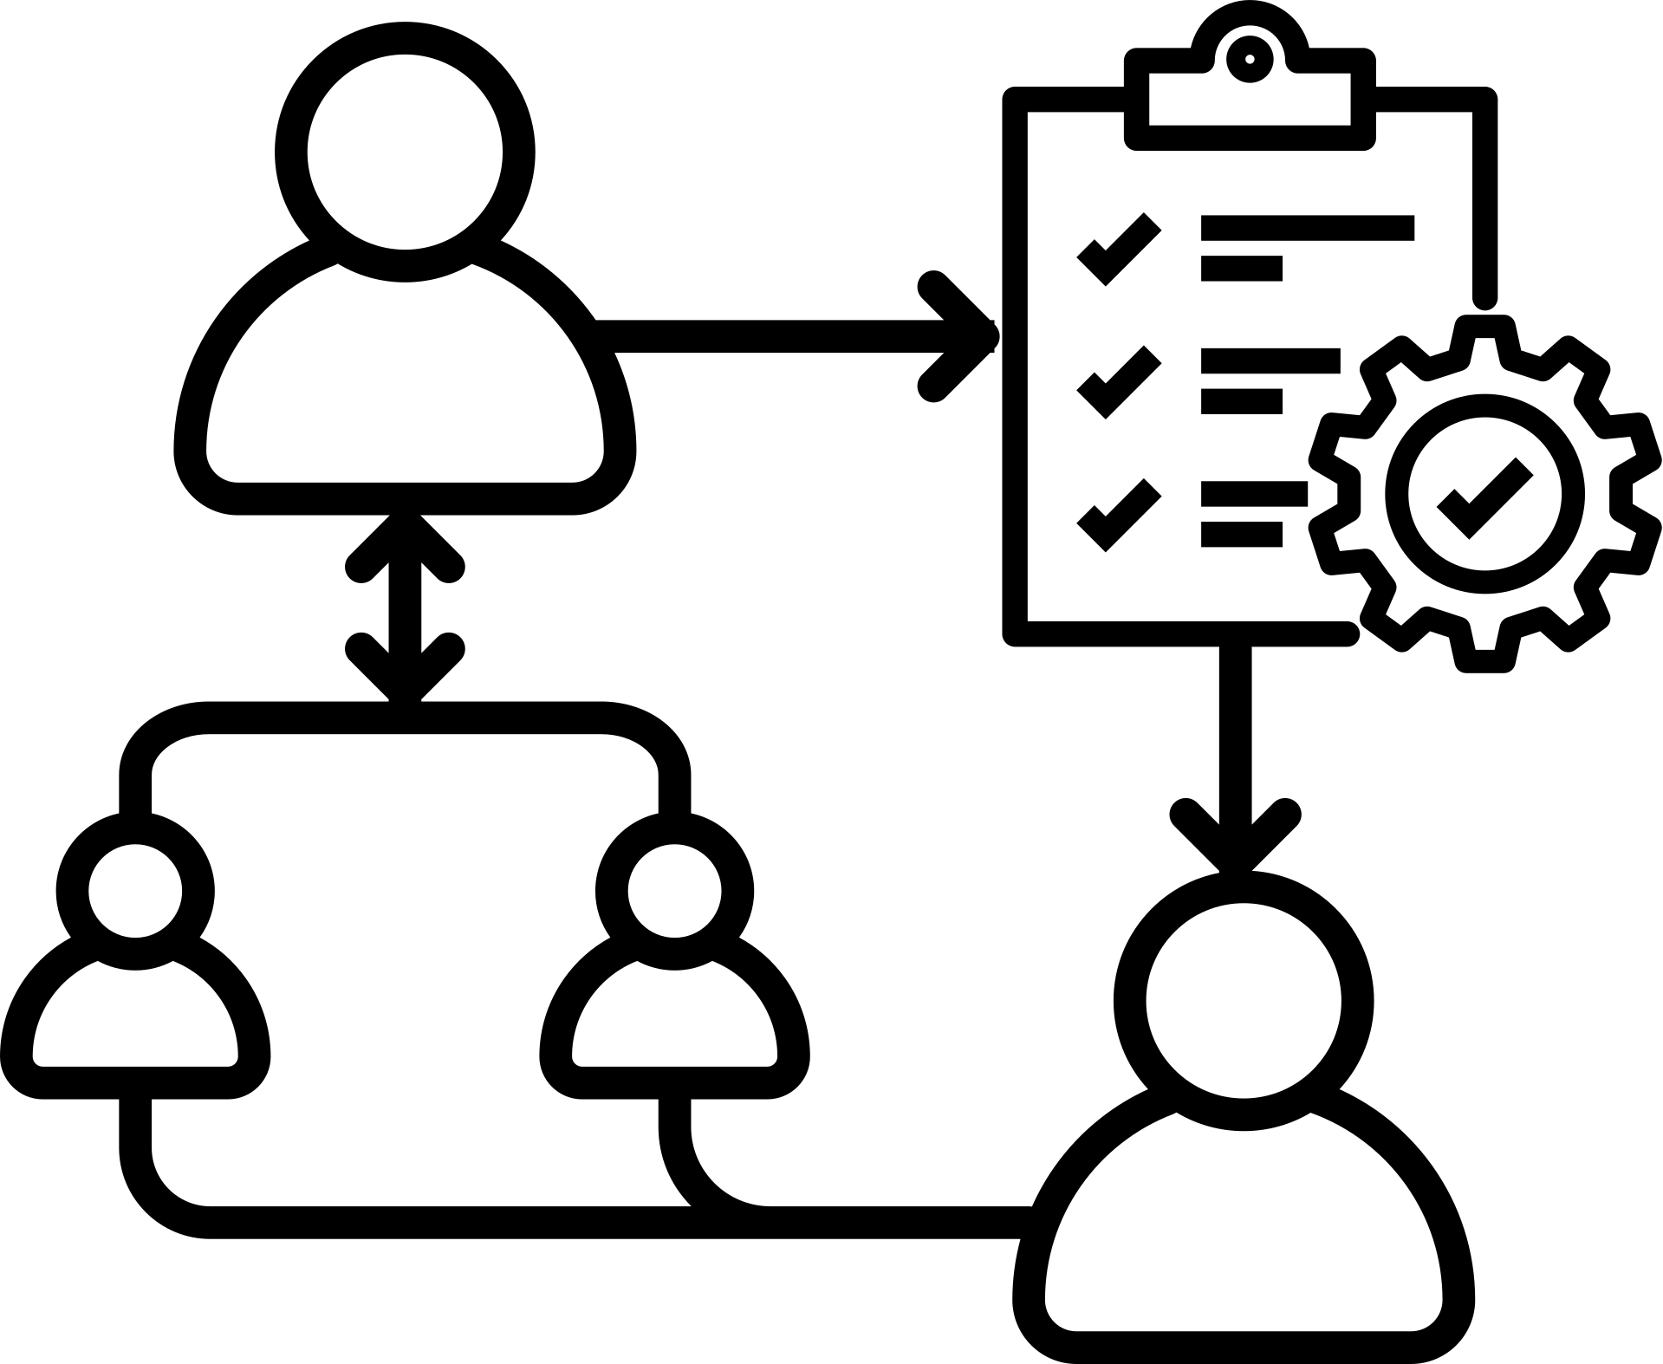


Importance
Creating meaningful learning environments
In-field training & building co-learning spaces
Mediated teacher-student role exchange process
Industry experts
& mentors
Activites
Stakeholders
Key concept
Methodology

Slide 4

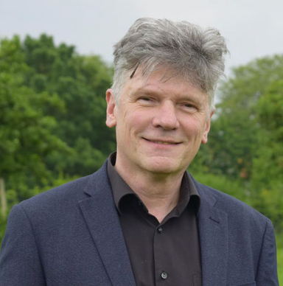
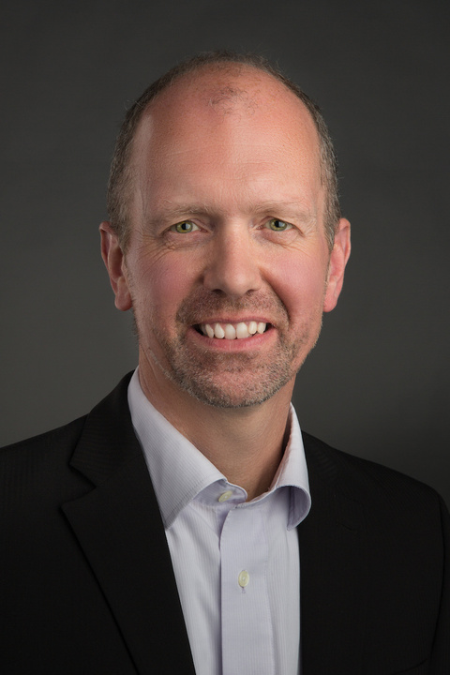

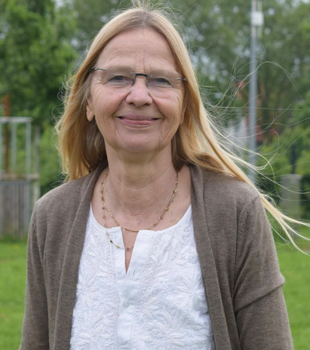



Roles
1
Lecturers/teachers
2
Workshop mediators
3
Student workers/young talent
4
Expert leaders & mentors

Slide 5



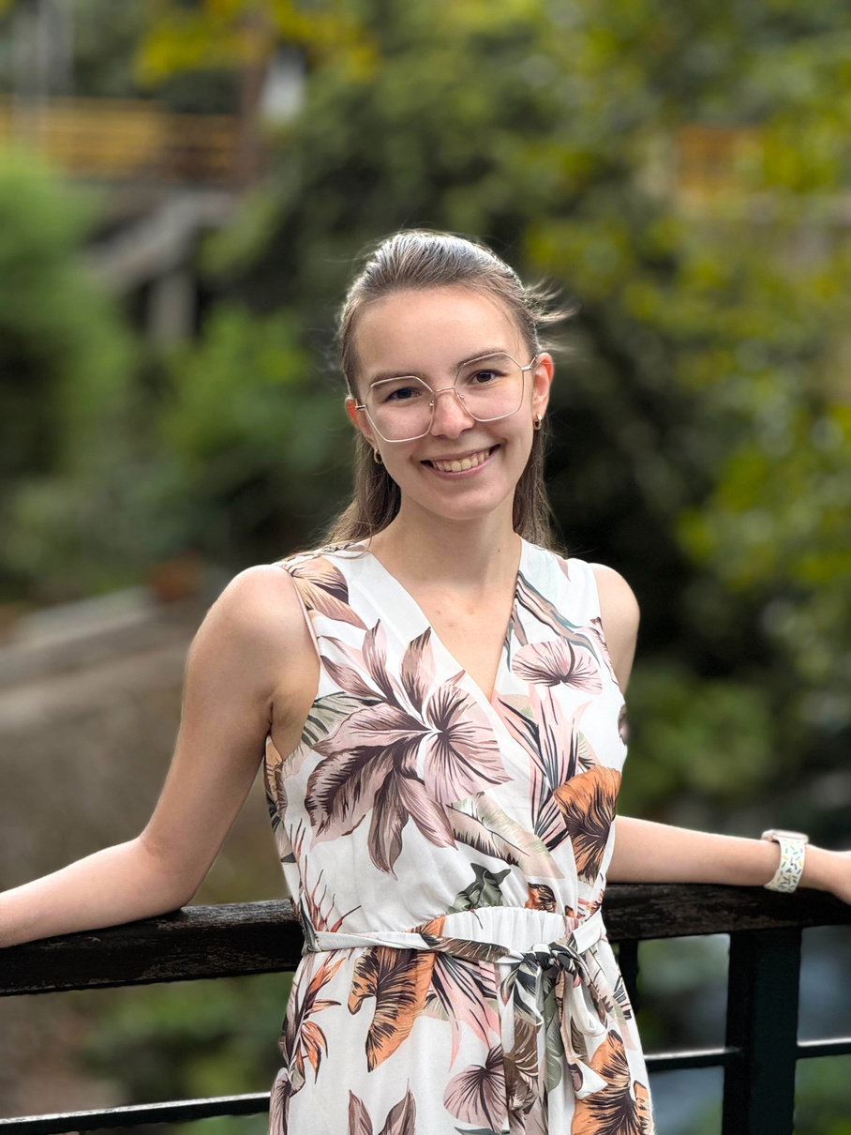

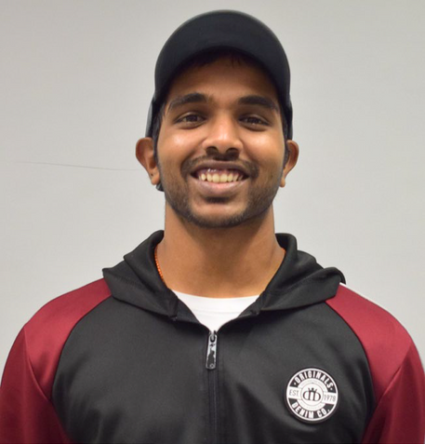




Roles
Student Workers a.k.a.
Young Talent

Slide 6
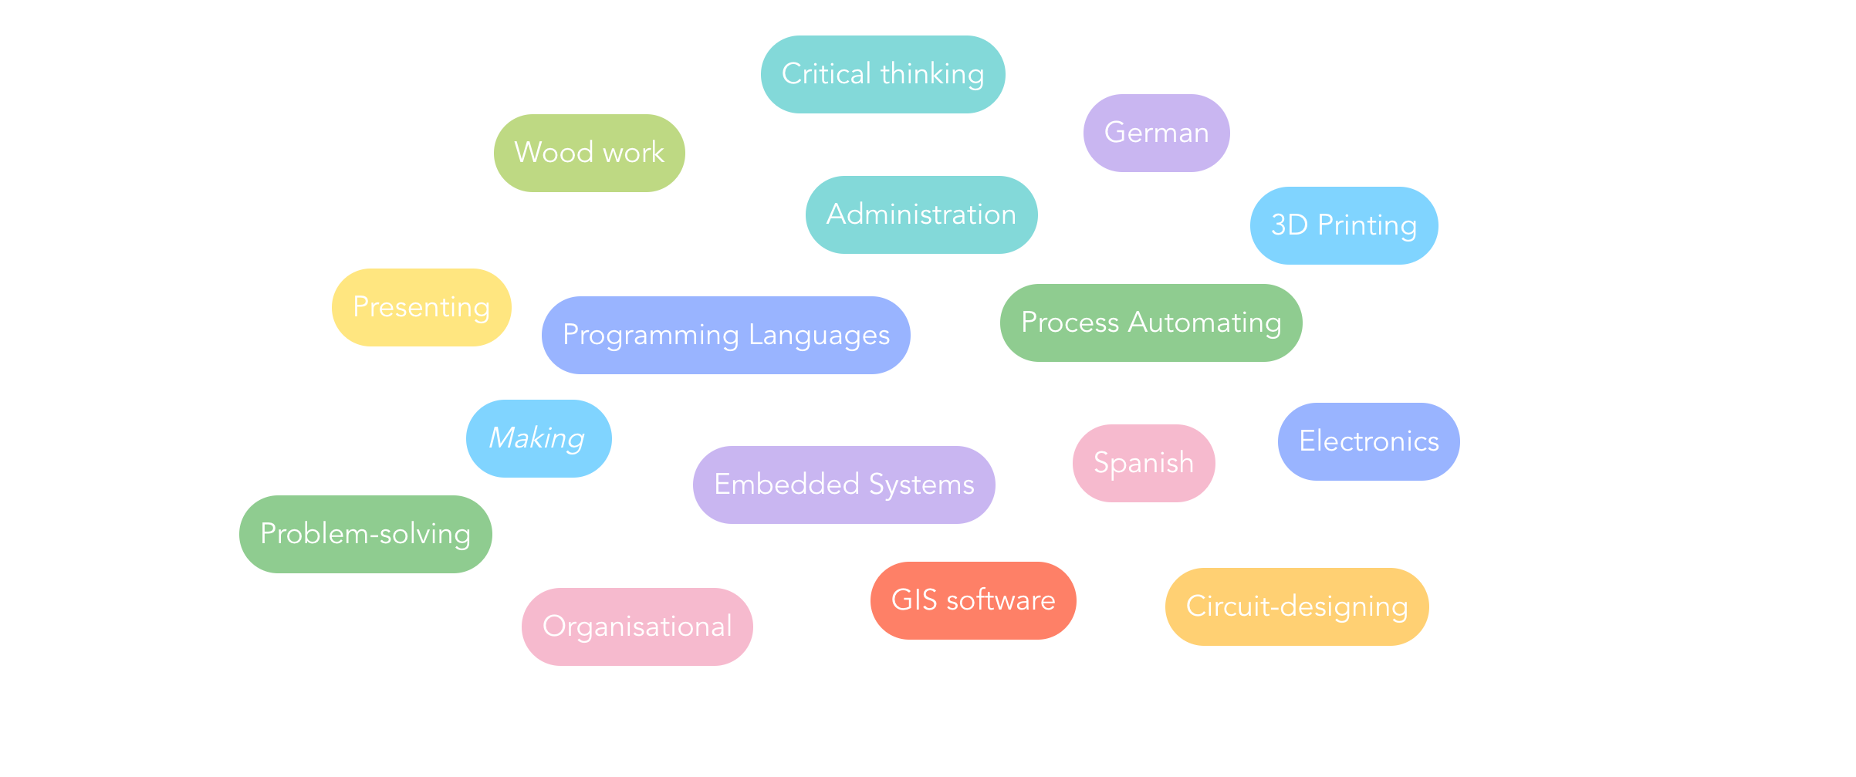





Slide 7


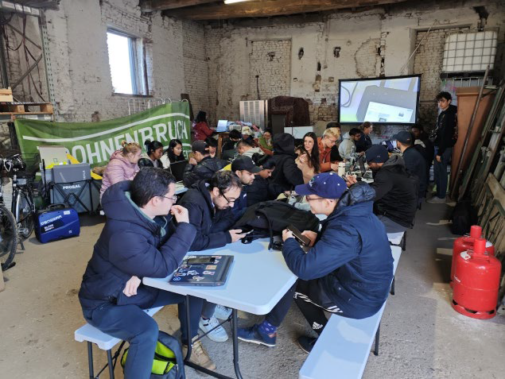
Activities
Excursions
Professional visits to partner companies
Workshops
Collaborative workspace for development of learning material
Field practicals
Practical implementation within course modules, incorporating field assessmen
Dissemination
In-class lectures and practical exercises

Slide 8
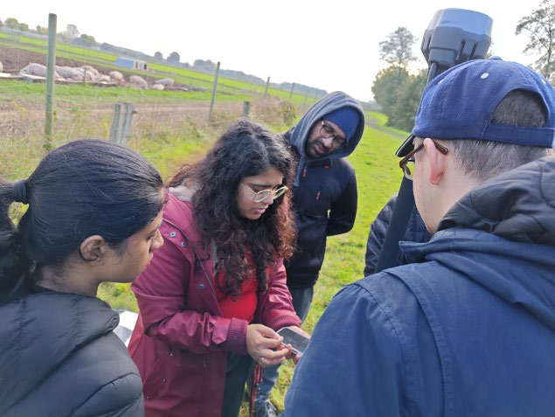
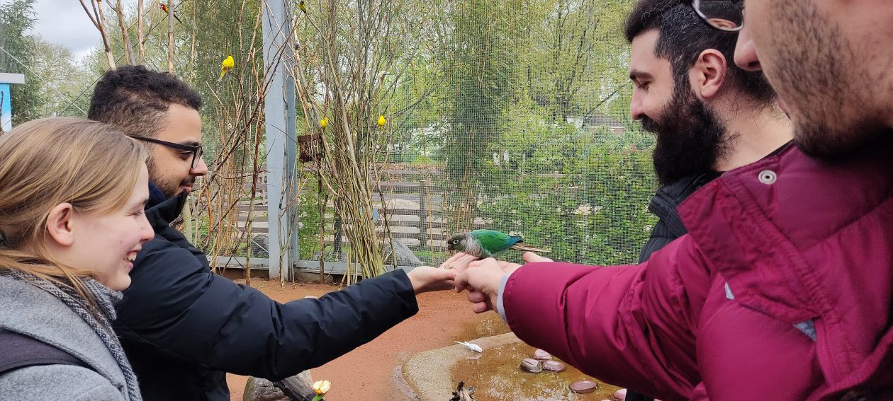
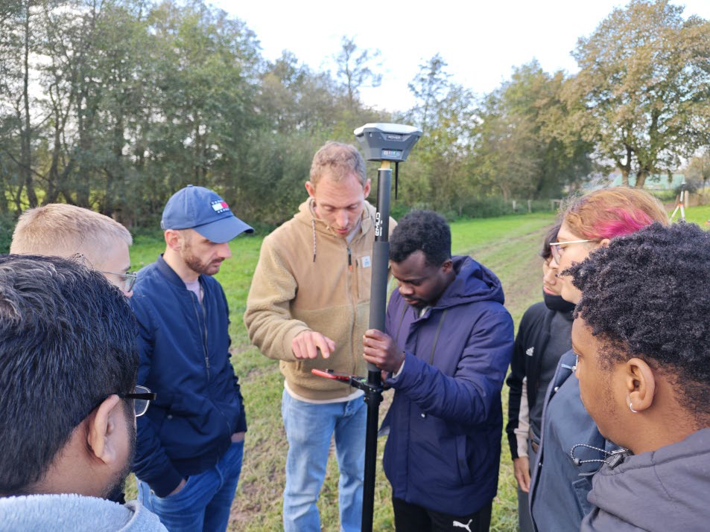
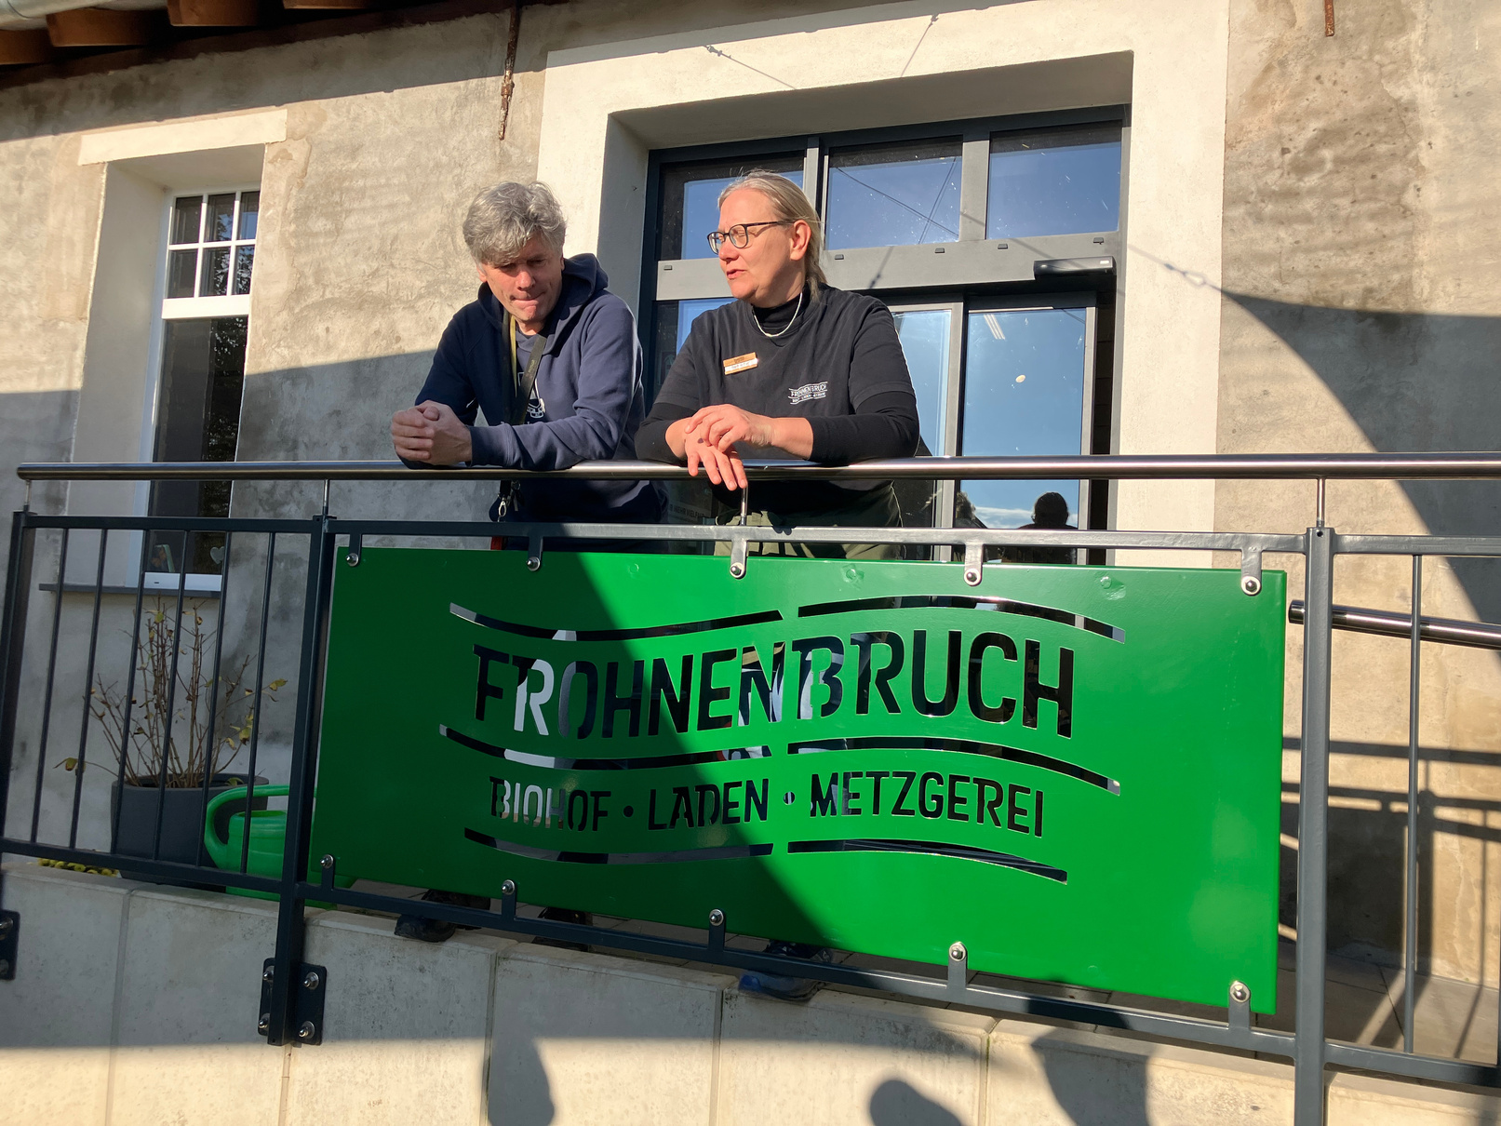
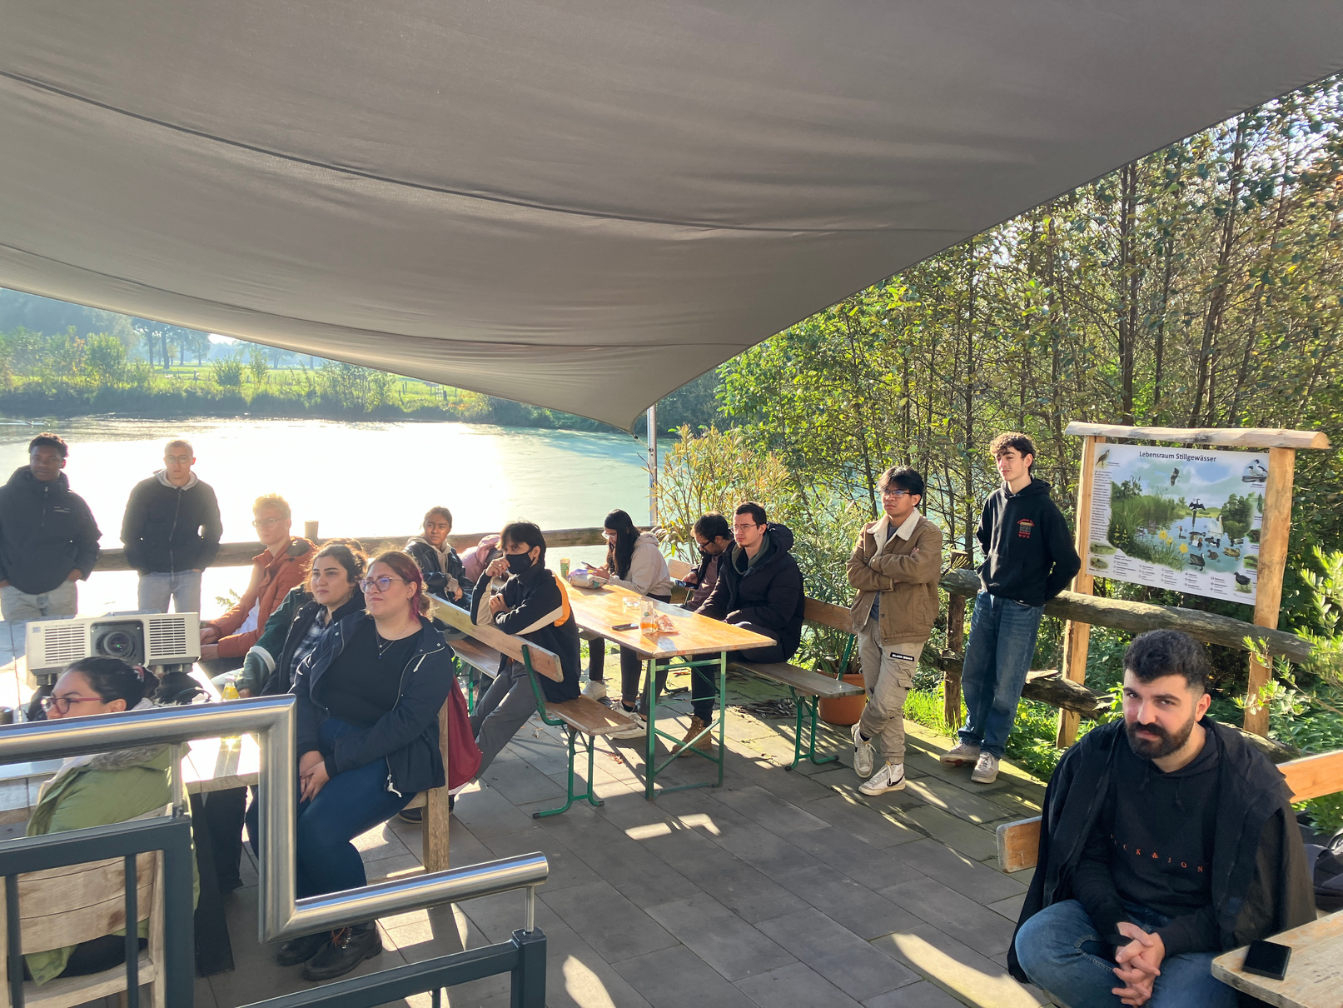

Slide 9
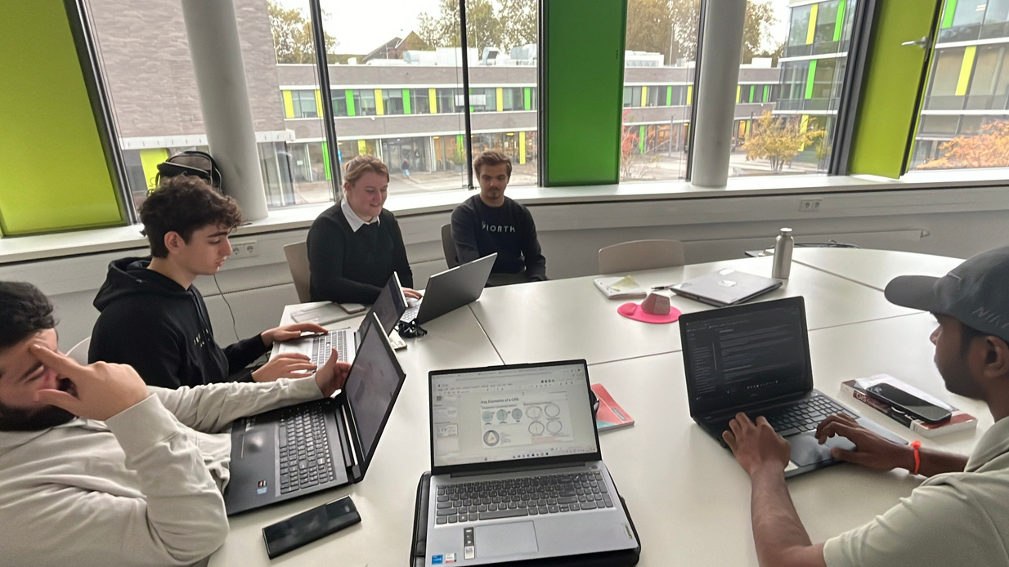
Workshops & Student-classroom
engagement
Motivating students to look forward to attending their classes
Motivation
Establishing a comfortable learning environment that promotes healthy dynamics between students and teachers
Comfort
Support
Students can find support in their peers as “role models”
Consistent co-creative and collaborative learning conjoined with strategic partners
Skill building

Slide 10
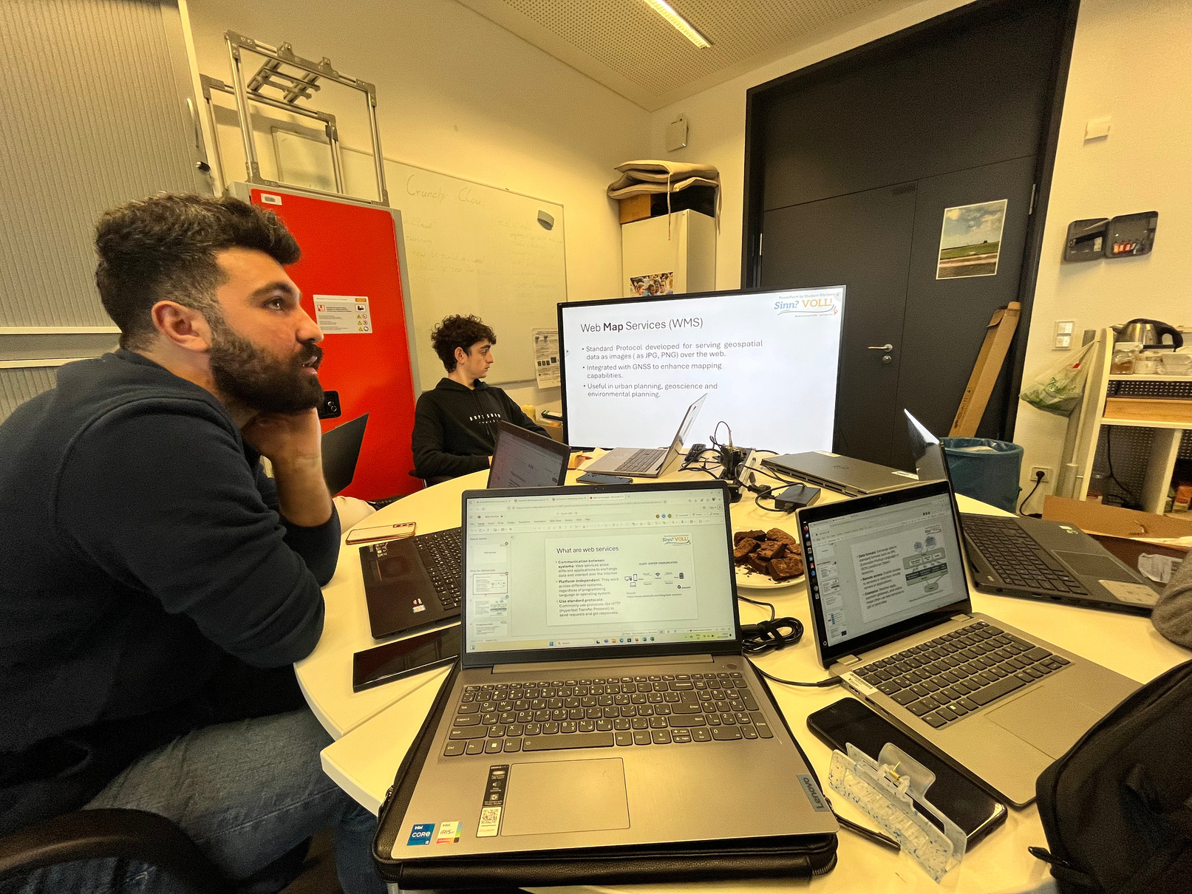


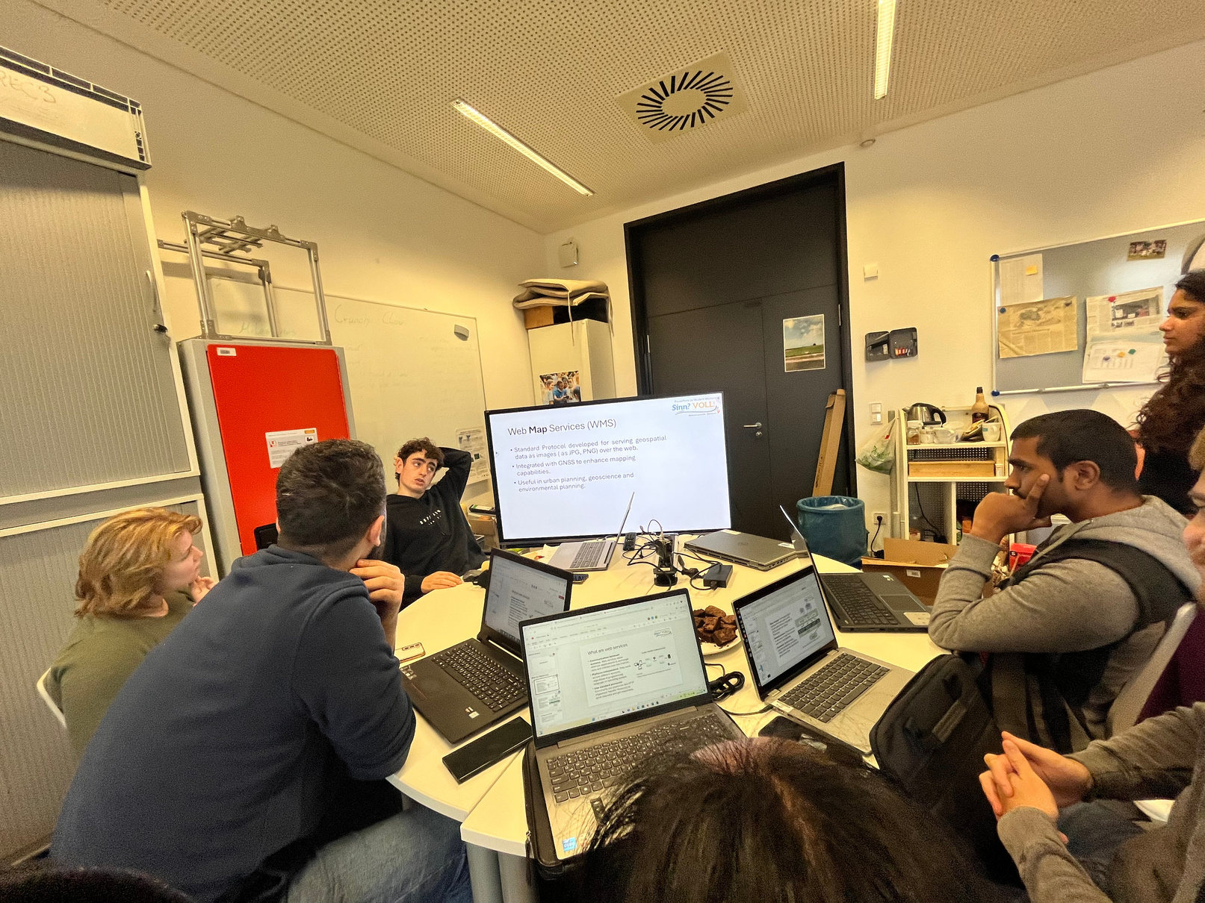


Slide 11
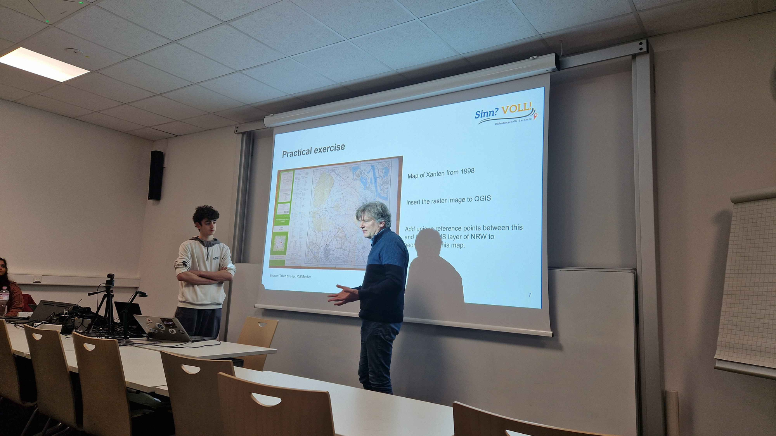
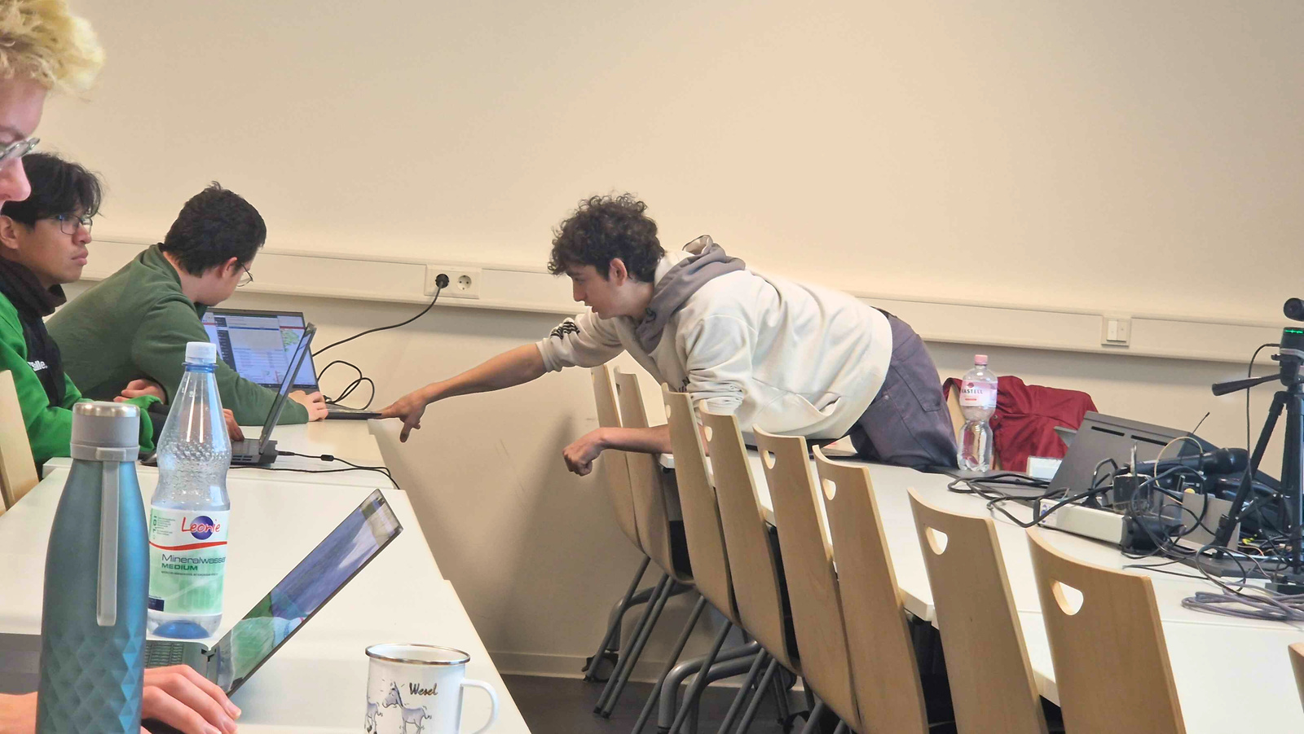

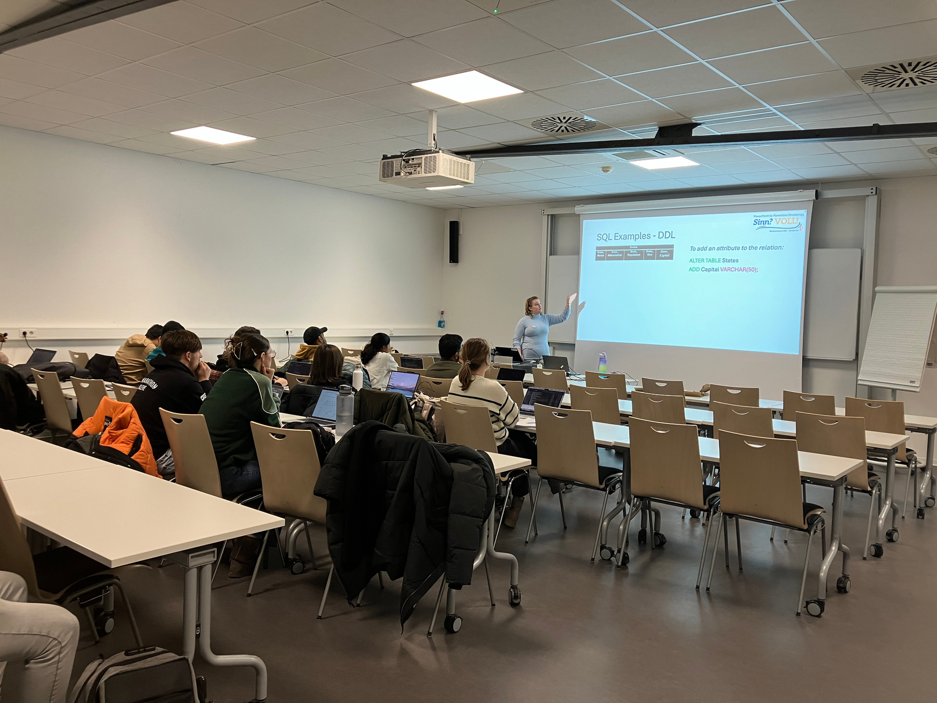
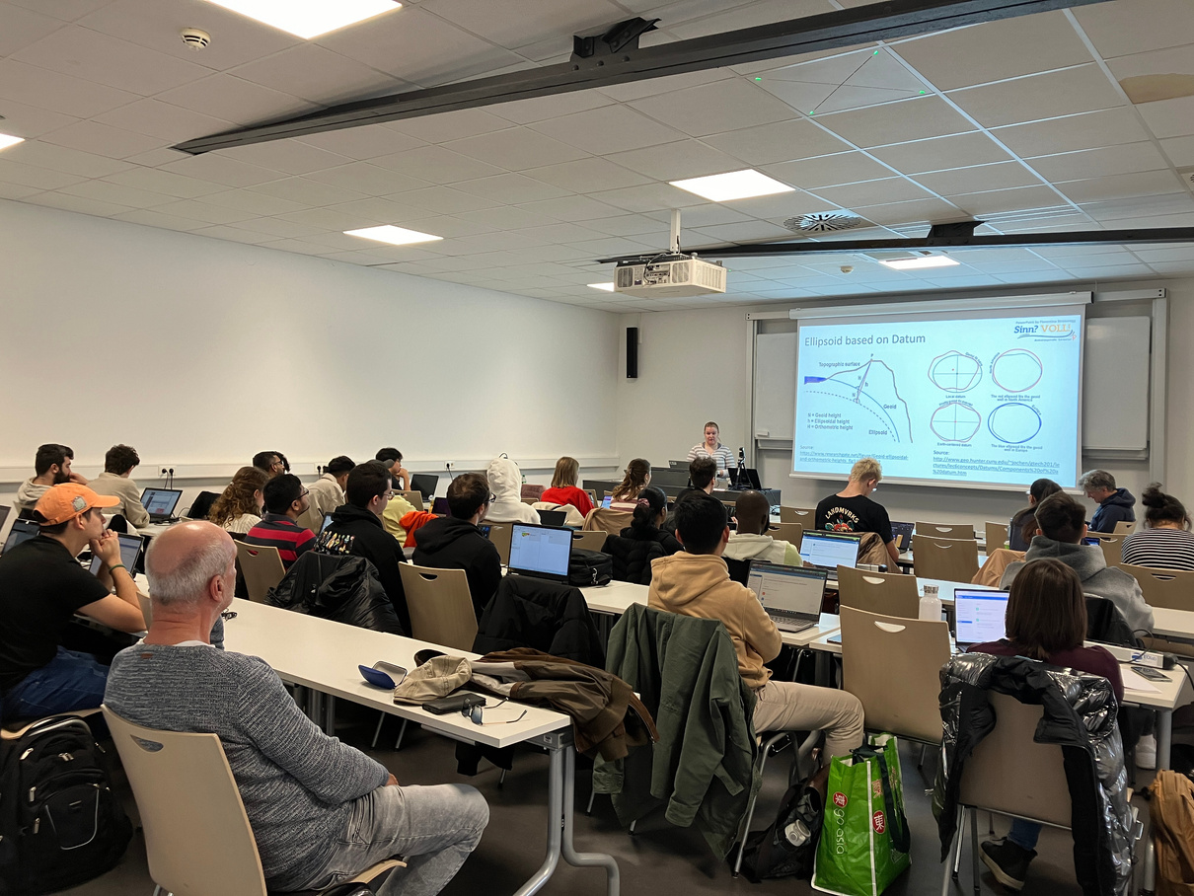
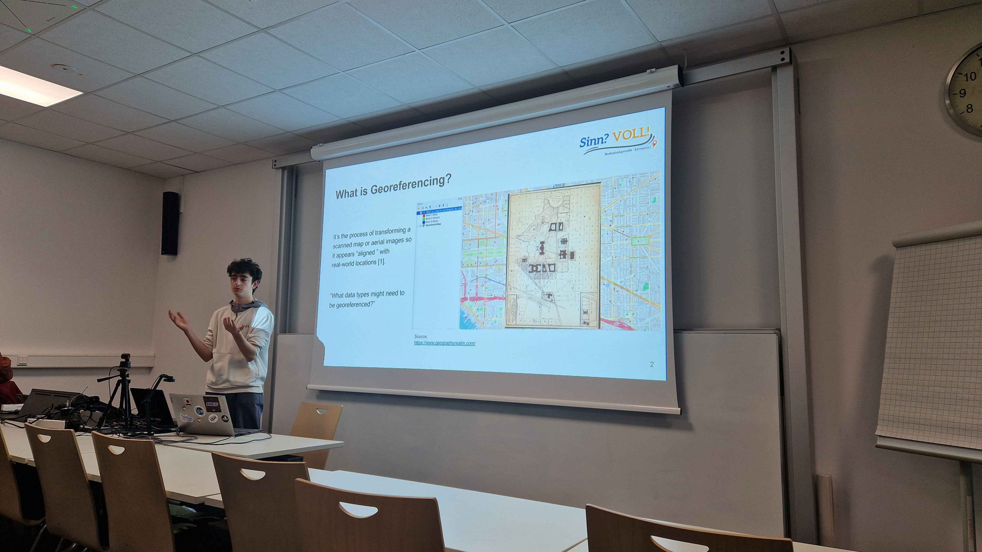


Slide 12
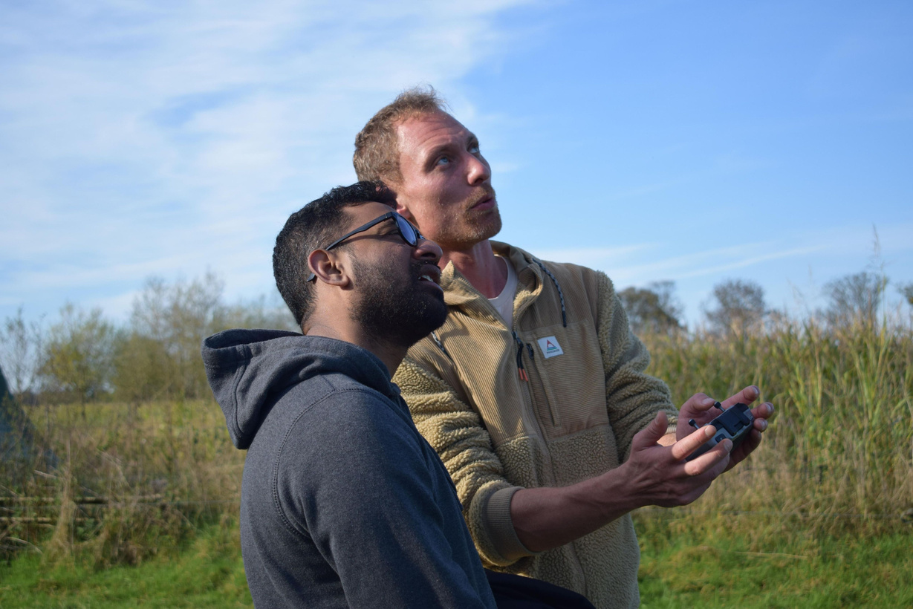
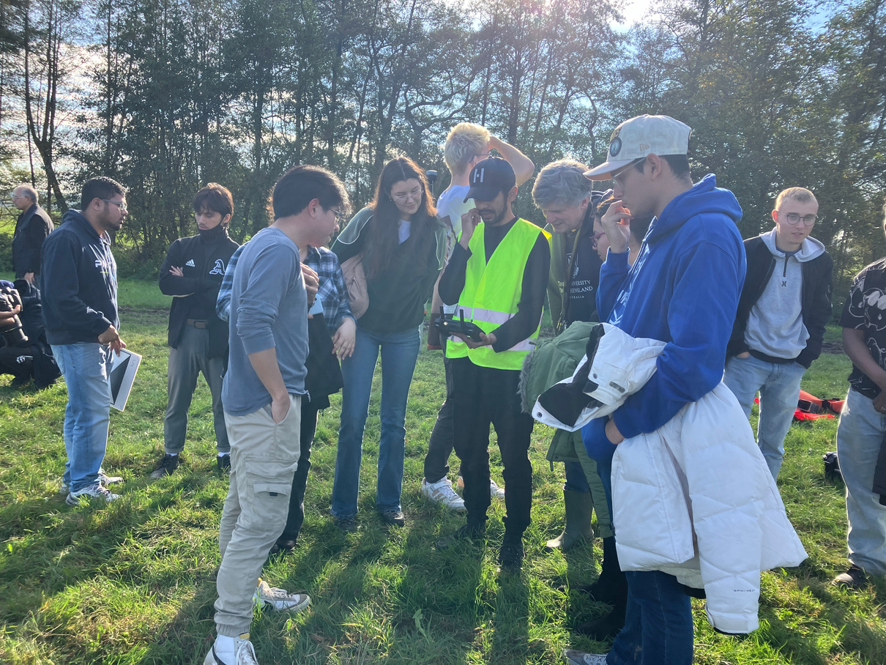
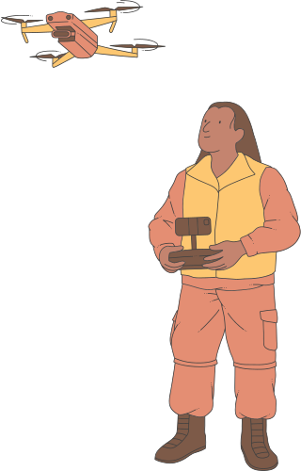
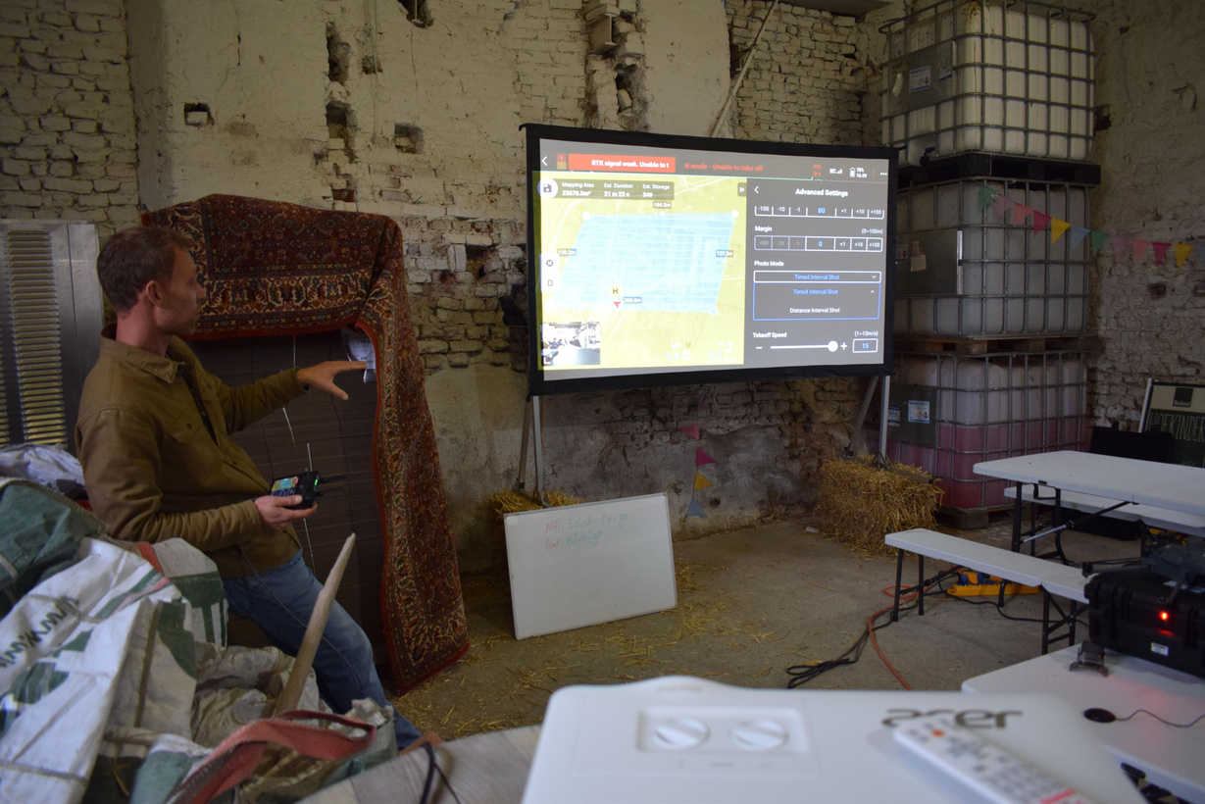
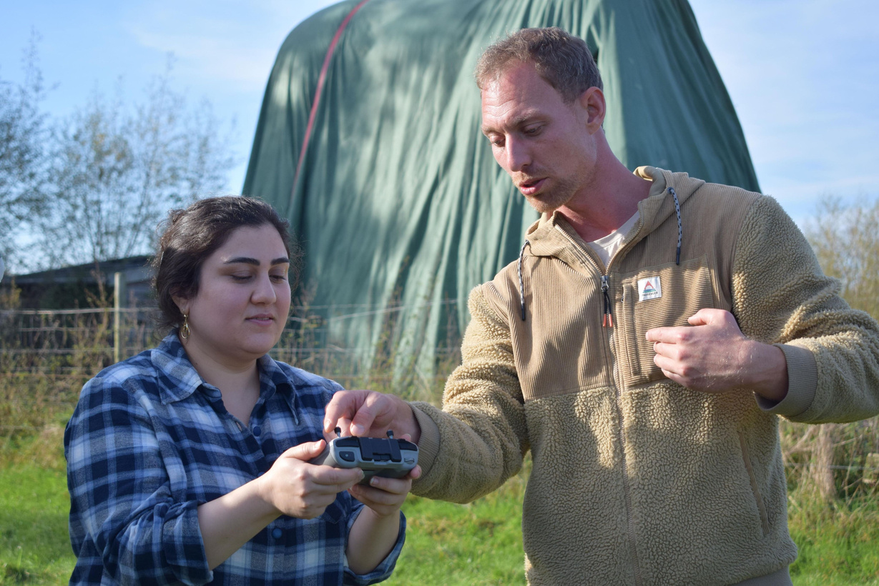

Slide 13


Challenges & Impact
Educational innovation
  Continuous evaluation of learning approaches
  Changes in skill-requirements
  External inhibitors in educational pathway
  Continued internship placements
  Soft-skill training
  Purposeful learning
  Enhancing STEM learning experience
  Up-to-date, continuously developed curriculum
  Collaborative skill & knowledge building
  Role-exchange and overlap
  Unwillingness to collaborate
  Hesitance to present
  Lack of confidence
  Diversity in learning interests
Social & Professional growth

Slide 14


Future Deliverables
1
Open Educational Resources: platform for learning material distribution
3
Workforce training in professional contexts
2
‘Market’ platform development for resource share and skill exchange
4
Reuse and reassessment of learning modules

Slide 15

Thank You!

