Slide 1











Lets Plaiy:
①Teaching part
②our idea
③Chinese program
①

Slide 2
Teaching part

Slide 3
Teaching Plan
1.Introduction of AI to children: (20mins)
- What is AI?
- The applications of AI in our daily life
- Why should we learn AI ( future use/trend )
2.Simple examples programmed by ‘Snap!’ (40mins)
- Show some examples( understandable, easy, interesting )
- Short Introduction about ‘Snap!’ programming
3.Basic skills get into ‘Snap!’ (60mins)
- Should base on the examples we have shown to the children, after teaching, we let them try by themselves and we help them when they need.

Slide 4
Provide some simple programs as a example to run on snaps to let them understand the basic usage.
Snaps
database
Through videos or pictures Teach them step by step to build their own database.
1
2
3
4
5

Slide 5
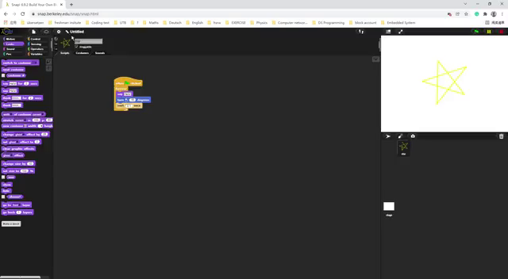

Slide 6












What is AI?
AI is Artificial Intelligence, which is a branch of computer science. It integrates mathematics, logic, statistics, computer science and other disciplines.
In fact, we have been exposed to artificial intelligence very early in our lives, such as mobile phones, sweeping robots, and smart speakers.

Slide 7
The applications of AI
    1. Artificial intelligence is mainly used in the following fields: robotics, language recognition, image recognition and expert system
      2. Robots are artificial intelligence robots. It is used to talk to humans and adjust their actions through various situations to achieve specific goals
      3. Language recognition refers to the conversion of language or sound into information that can be processed

Slide 8
  4.Image recognition refers to the use of computers for image processing, analysis and understanding, to recognize various targets and objects in different modes.
  5.Expert system means that the database used in the background is equivalent to the human brain and has a wealth of knowledge reserves.It uses various data and knowledge reasoning techniques to simulate experts to solve complex problems.

Slide 9
Why do we need to learn Artificial Intelligence?
AI is powerful.
The possibilities are truly endless.
Preparing a job as a software/hardware engineering..

Slide 10




How to take photos and lable them?
1. Video capturing，named the images
2. Storing images in a file
3. Data preprocessing

Slide 11
Idea

Slide 12
1
2
3
4
5
Introducing simple concepts
Understand what AI is, the software, the hardware and the datebase, make them empathize with AI by giving examples from their lives as much as possible, rather than making them feel like it's something new.
Understand what code is and the basic knowledge that needs to be used in it. Let them understand what some code does and give some simple examples. Raise their interest through demonstrations that won't make them feel cofused about code at the beginning. Of course, we will increase the difficulty step by step as they learn.

Slide 13
Gradually increase the difficulty to
make learning fun
By setting many tasks and increasing the difficulty step by step. We can set game levels, adventure levels and so on. And they can earn game coins or points for passing them, making learning fun.
1
2
3
4
5

Slide 14

Teamwork
Reinforce the group work of the teens. so that they know the role of partners and help each other. It can also serve as a motivating factor. So that they will not give up easily.
1
2
3
4
5

Slide 15










1
2
3
4
5
transfer learning
The tasks we provide should be as close to life as possible, so that teens can do more hands-on practice, thus accumulating experience from practice, discovering new knowledge, finding similarities between existing knowledge and new knowledge, and use them for transfer learning.

Slide 16
Example
Chinese program

Slide 17
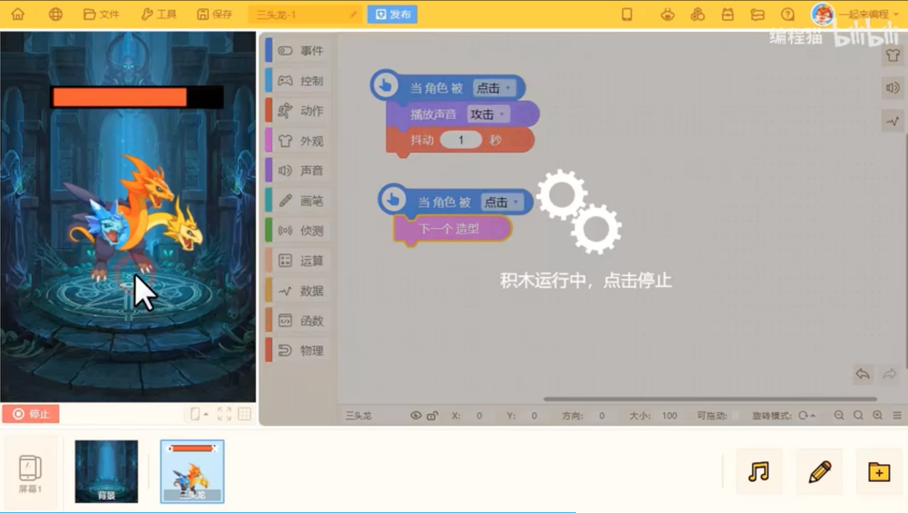
A video example about programming for children in China.

Slide 18
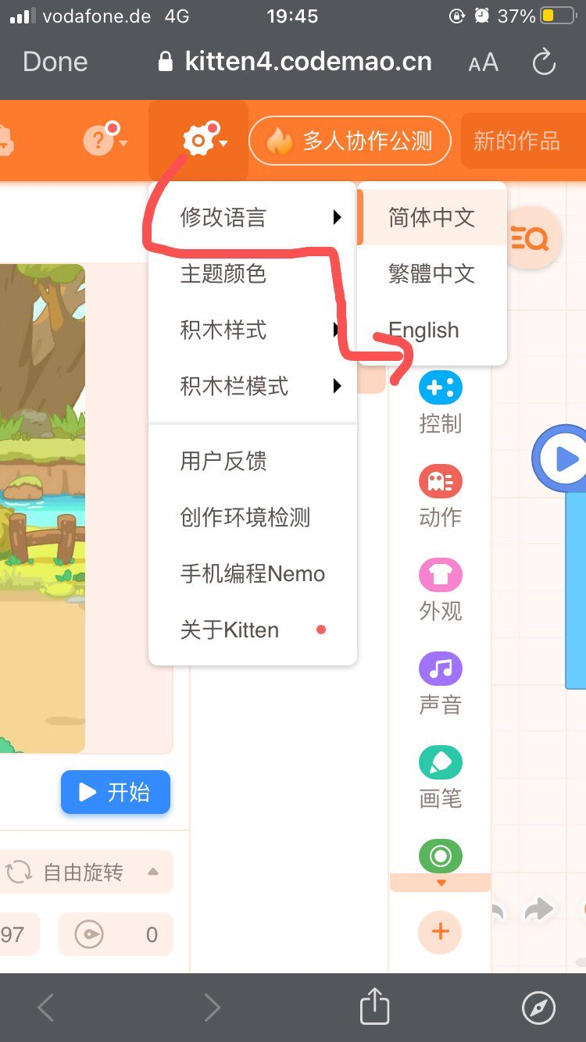
https://box.codemao.cn/

