Slide 1
Let's plAIy! – Object Detection in Snap!
NVIDIA Jetson | JetBot | Tello Drone
Rolf Becker | Harley Lara
Ali Farzizada | Ilgar Rasulov | Shreya Gupta
– Rhine-Waal University of Applied Sciences –
hsrw.eu | eolab.de | fablab.green

Slide 2
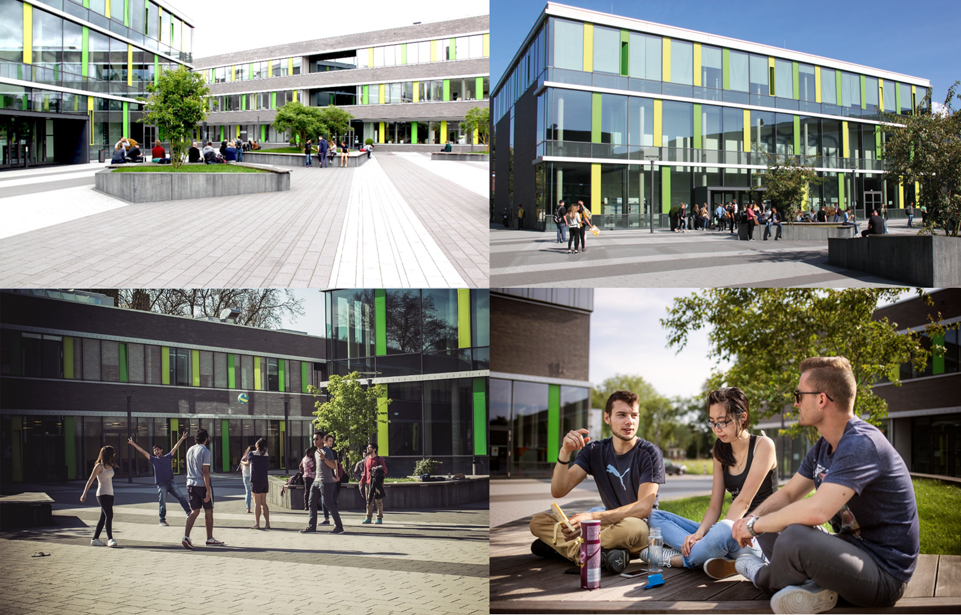
Rhine-Waal University of Applied Sciences (hsrw.eu)
Campus Kamp-Lintfort

Slide 3
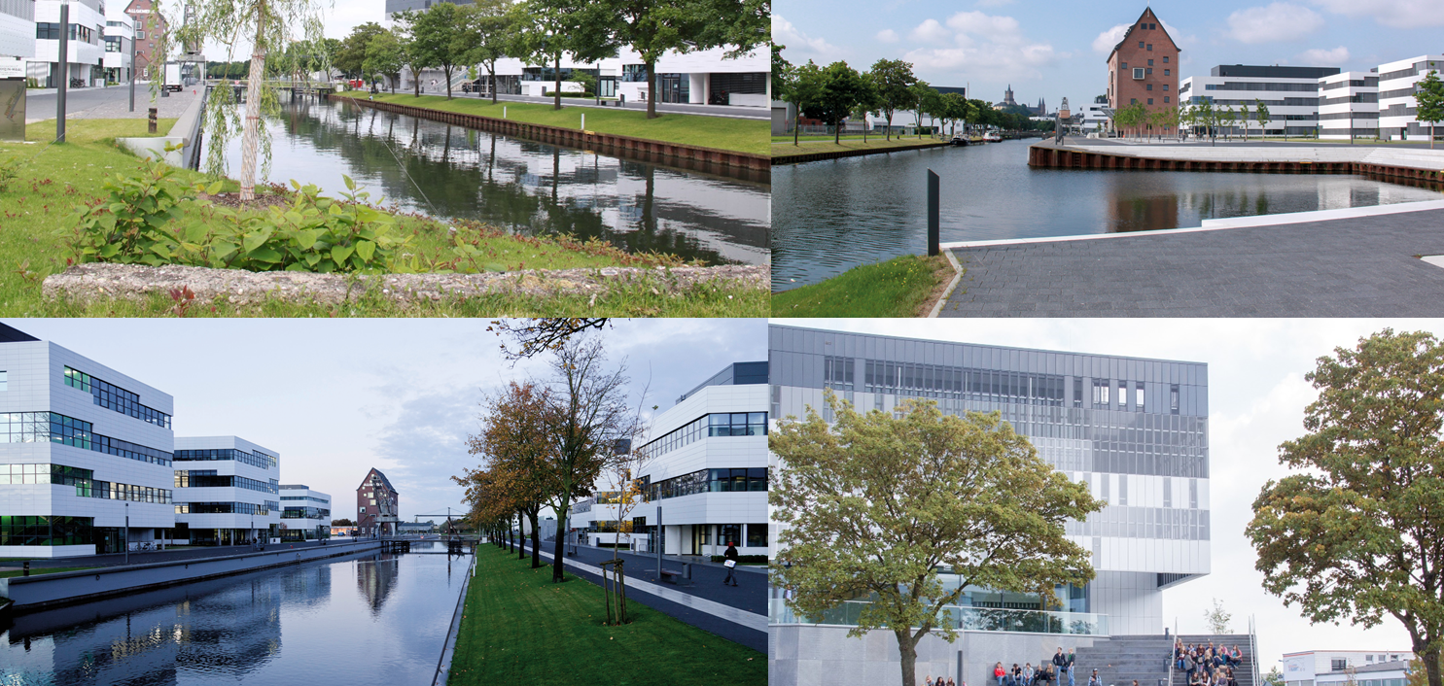
Rhine-Waal University of Applied Sciences (hsrw.eu)
Campus KLEVE

Slide 4
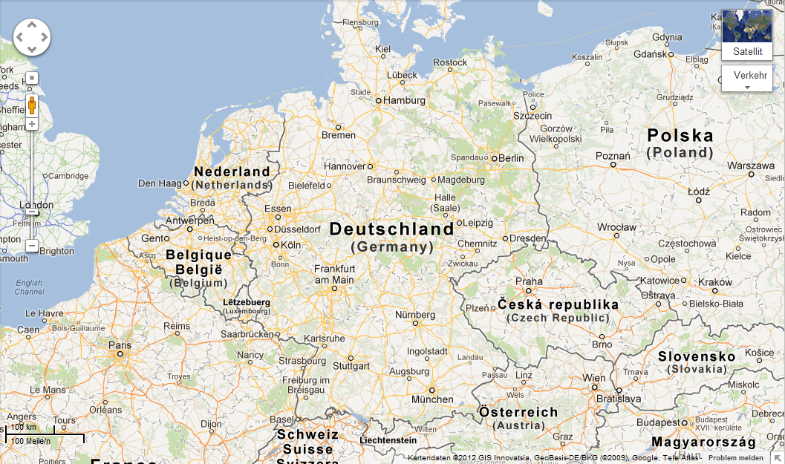
Lower Rhine Region, close to the Netherlands
Berlin
Cologne
NRW
Munich
Bavaria

Slide 5
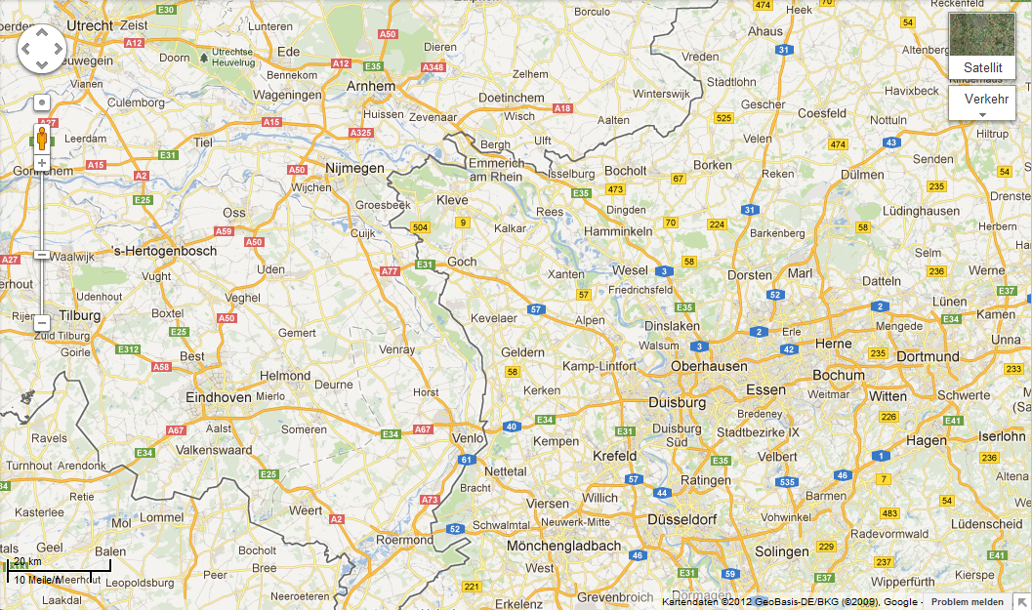

North Sea
DE
NL
Cologne

Slide 6
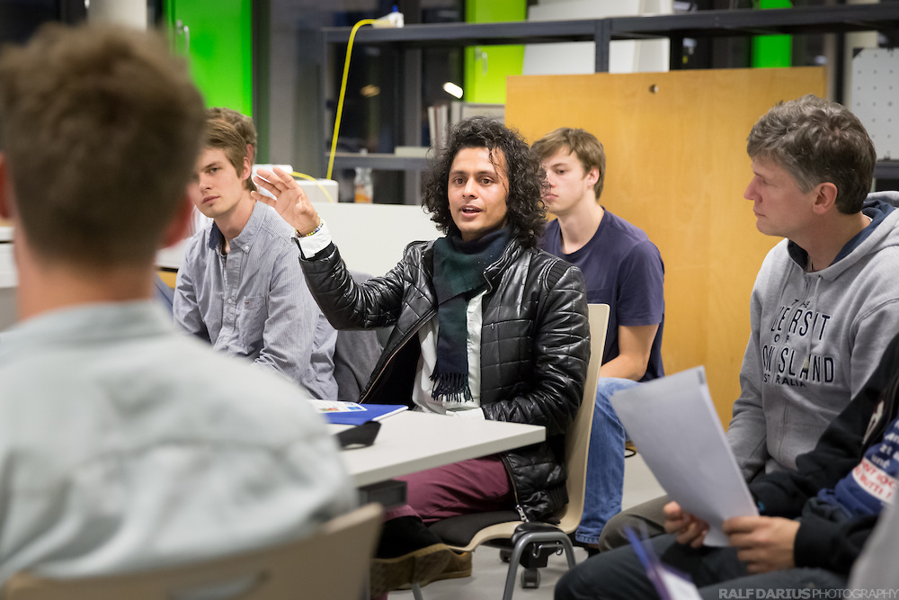
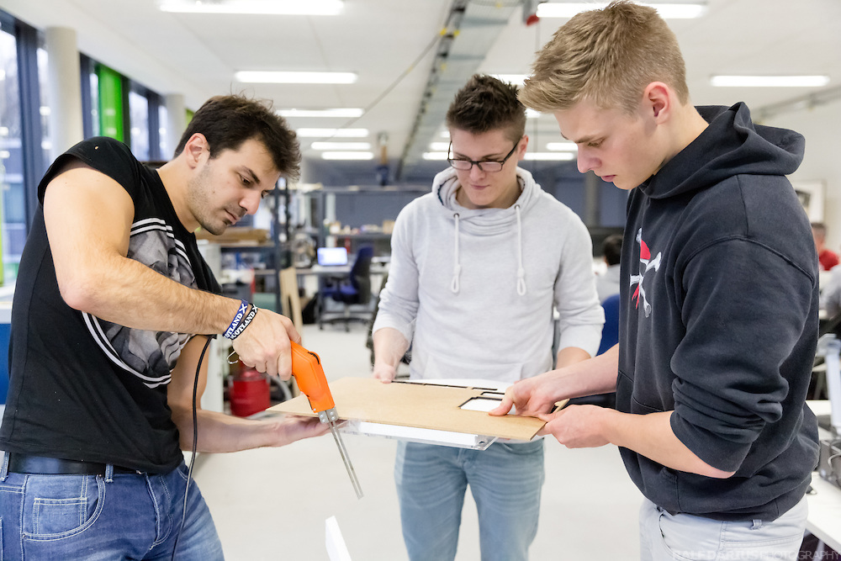
Learning in an Inspiring Atmosphere

Slide 7
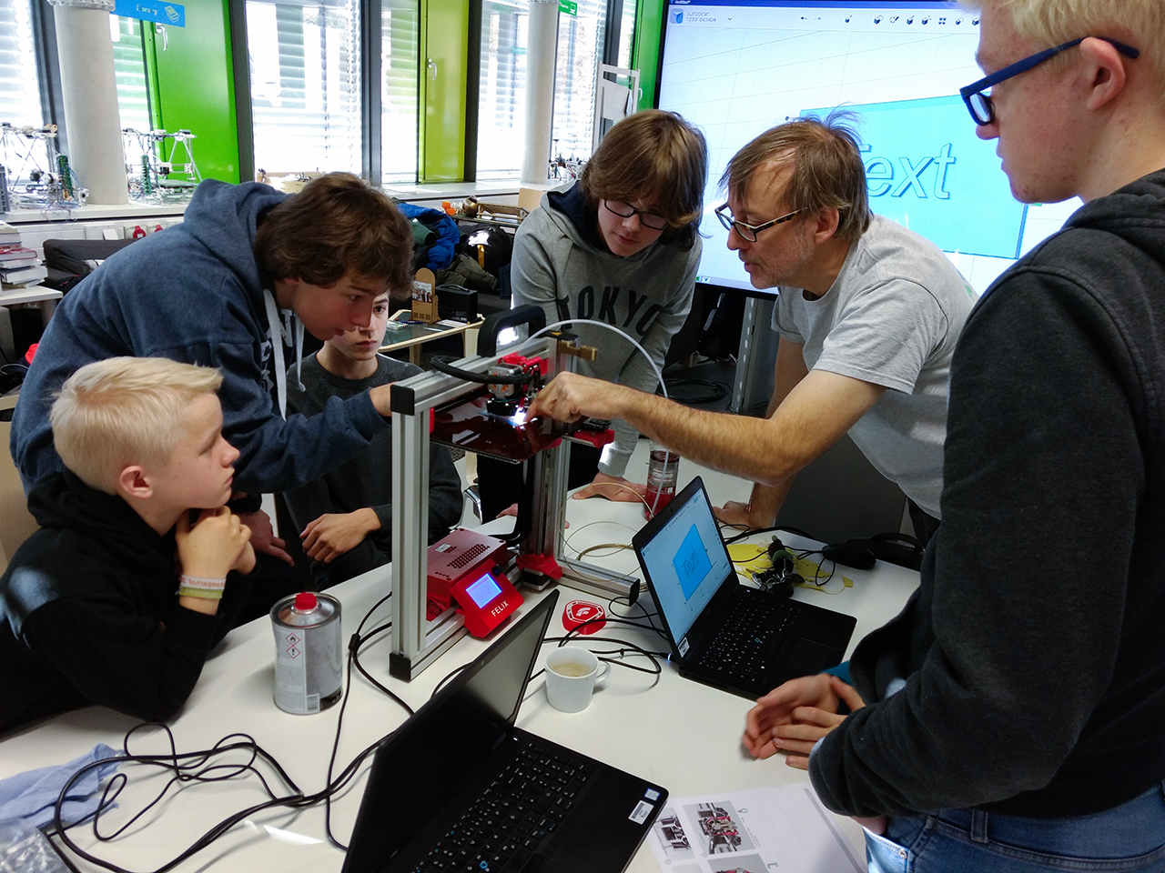
Spreading STEAM
School Fab Lab Network: 20+ Schools
Events at the HSRW Fab Lab, Trainer Mark Kohlen

Slide 8
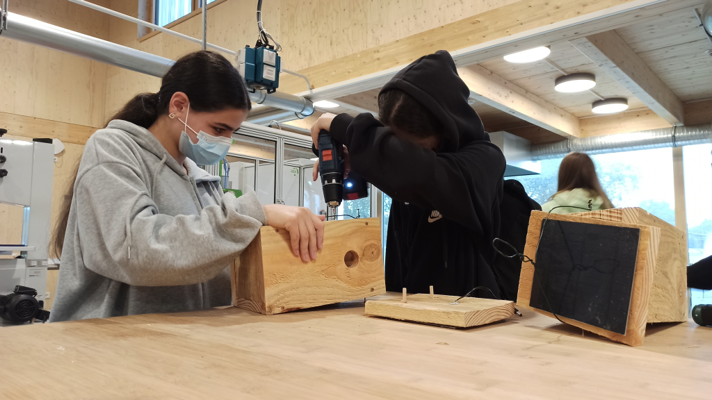
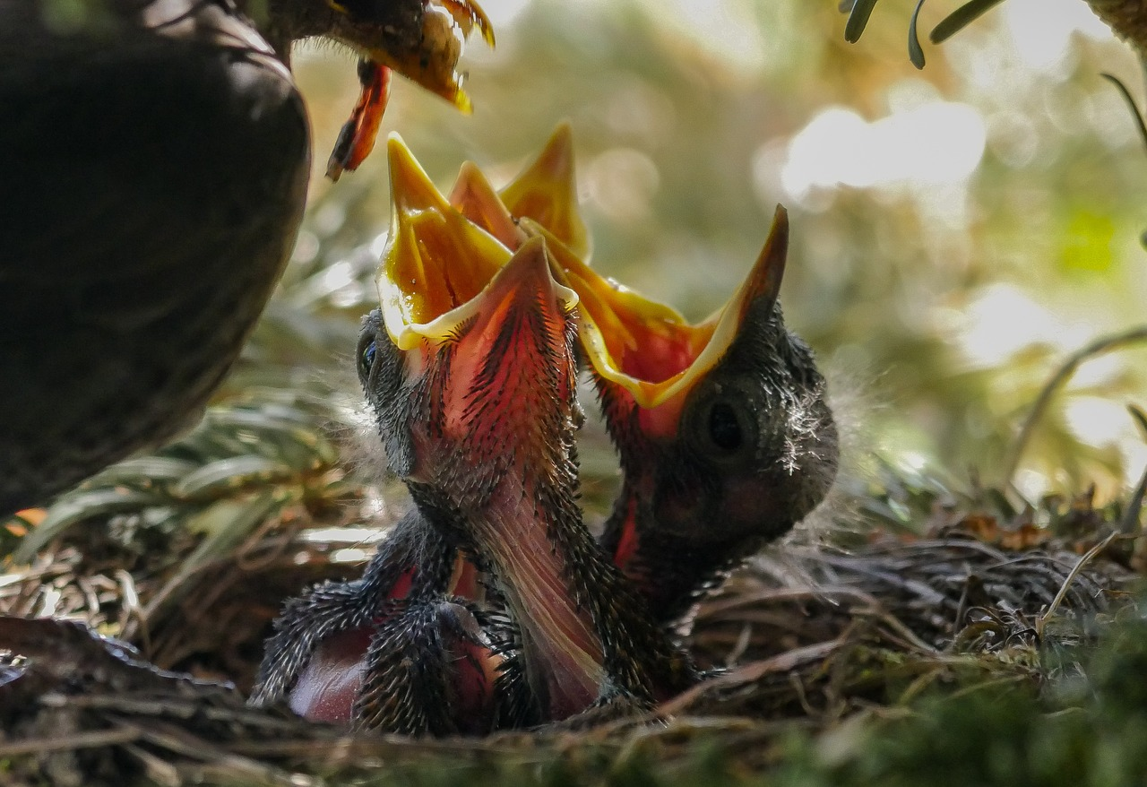
Why Snap? Why AI?
Motivating STEAM at schools
Integrating Snap!
in FabLab@Schools network
Crossover between CS
and life sciences (e.g. ecology)
Using AI for the common good
Learning AI and critical reflection
Earth observation research
(e.g. conservation, prec. farming)
Bird nest boxes with cams at the Green Fab Lab (HSRW)
Gerhard@Pixabay

Slide 9
Why Snap? Why AI?
Motivating STEAM at schools
Integrating Snap!
in our School Fab Lab network
Crossover between CS
and life sciences (e.g. ecology)
AI for the common good
Earth observation research
(e.g. conservation, prec. farming)
Bird nest boxes with cams at the Green Fab Lab (HSRW)
Observing Birds (Gerhard@Pixabay)

Slide 10
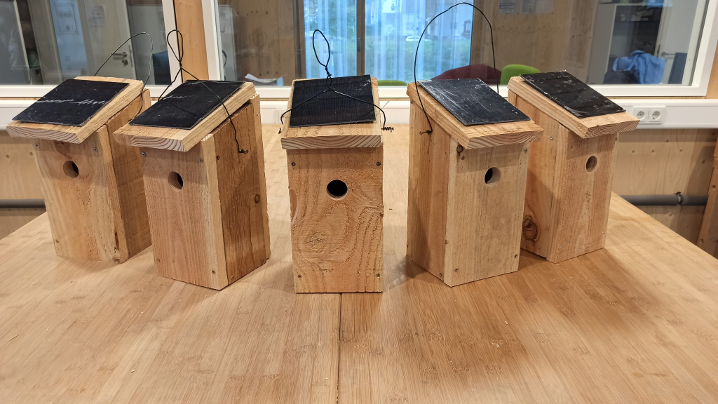
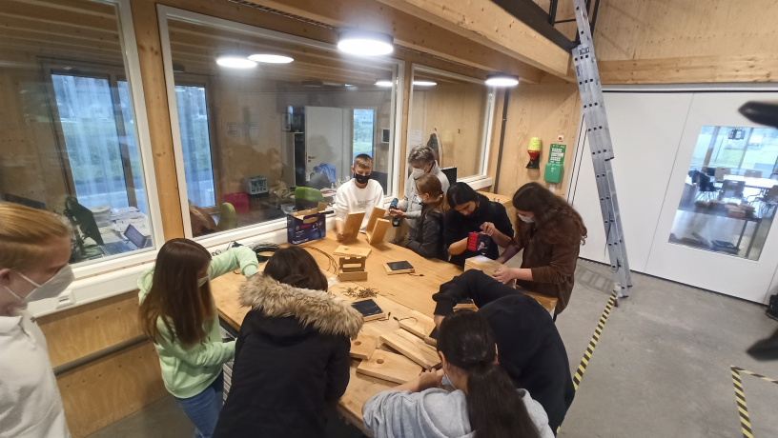
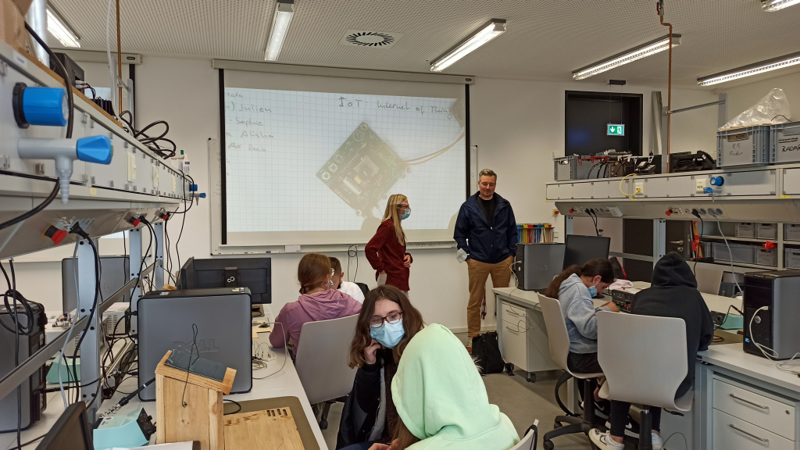
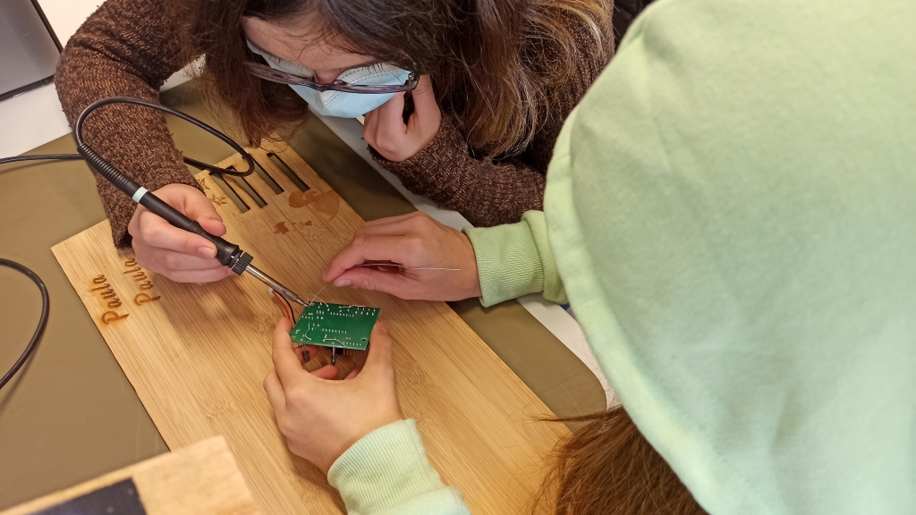

Slide 11
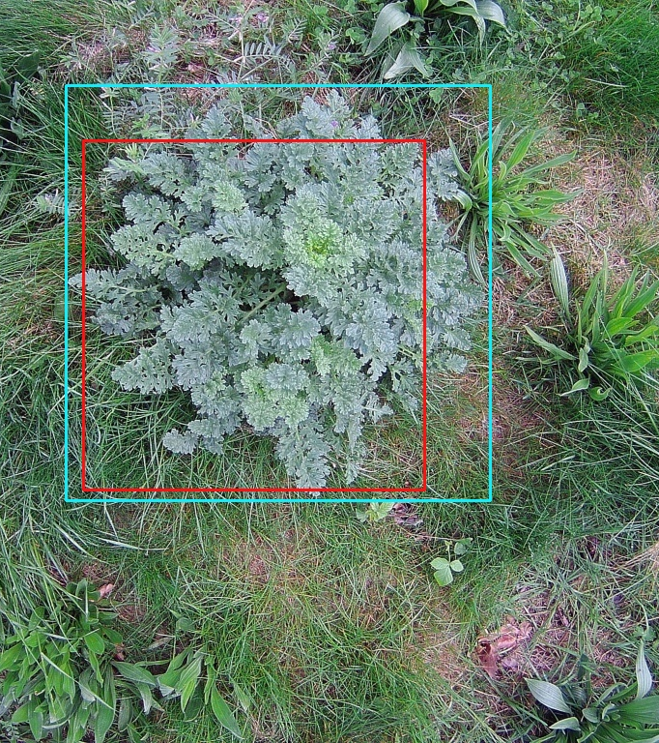
Object Detection Based On Convolutional Neural Networks Of Senecio jacobaea For Weed Control
Bachelor Thesis by Jonas Zender (21125)
1st Supervisor: Prof. Dr.-Ing. Rolf Becker
2nd Supervisor: Prof. Dr. Daniela Lud

Slide 12
Environ-mental Sciences
Drones, Robots
STEAM,
Snap!
Computer Vision
Scientific Compu-ting

Slide 13
Nesting Box with Web Cam
(applicable to Bird Feeders, too)
Images: Heise c‘t Make 1/21

Slide 14
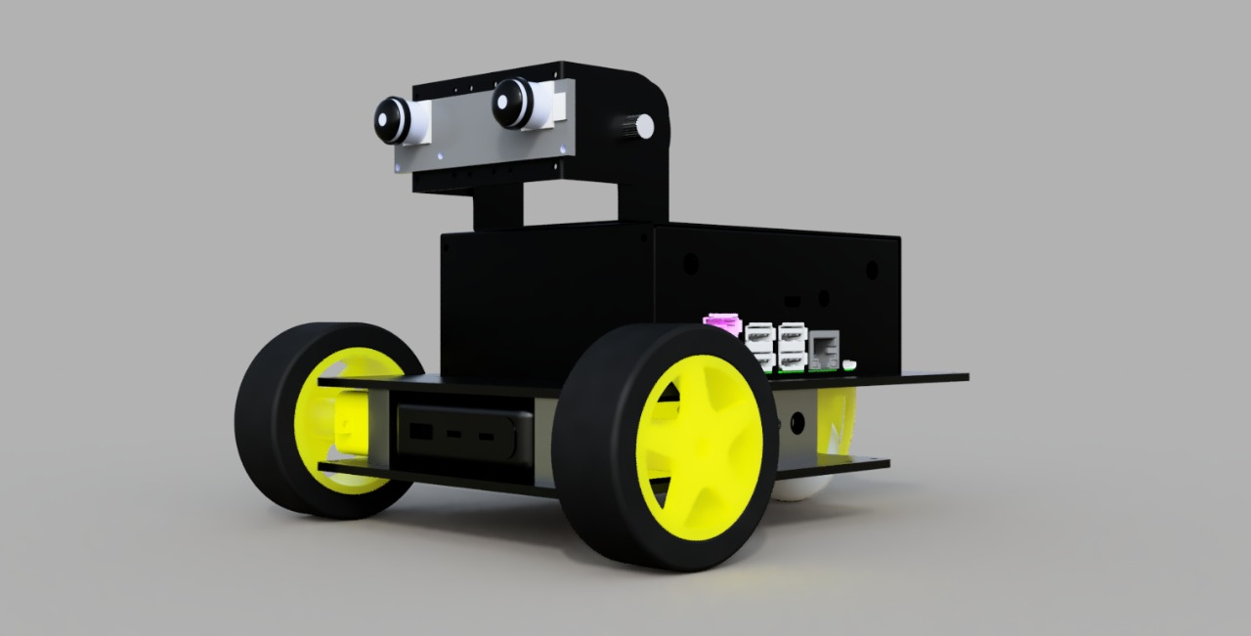
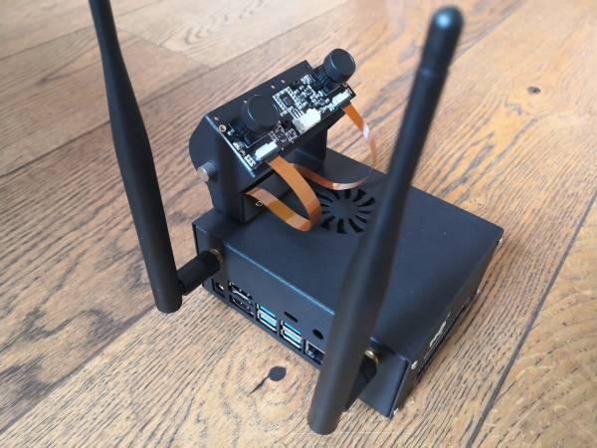
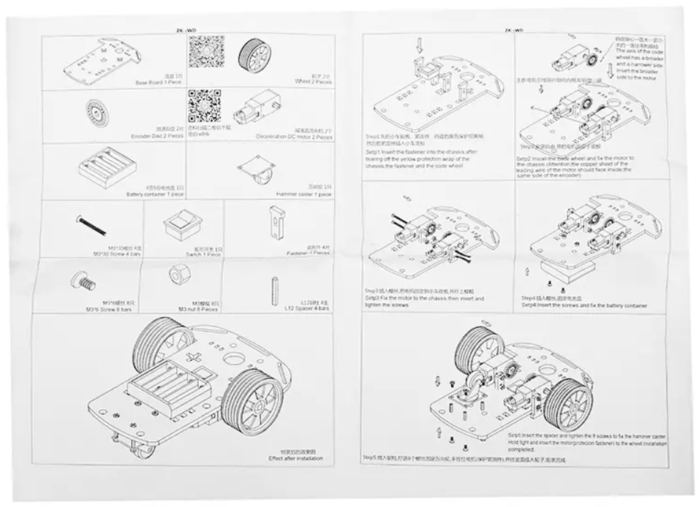
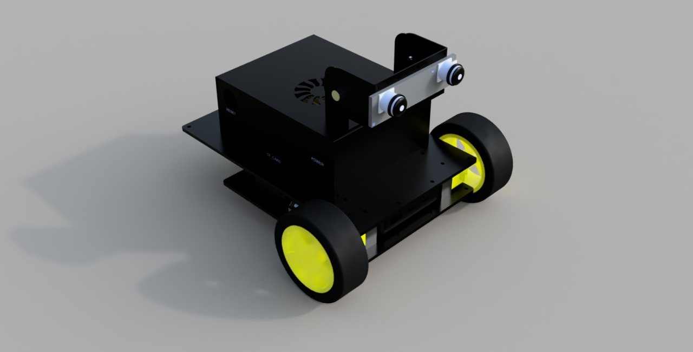
HSRW Jetbot-Version

Slide 15
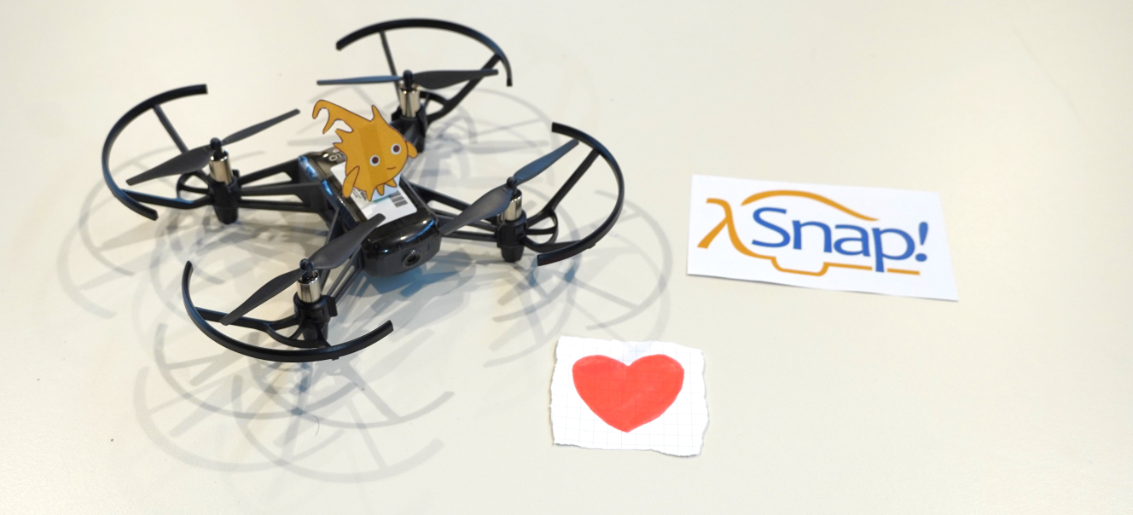
Demonstration 1: Snap! & Tello

Slide 16
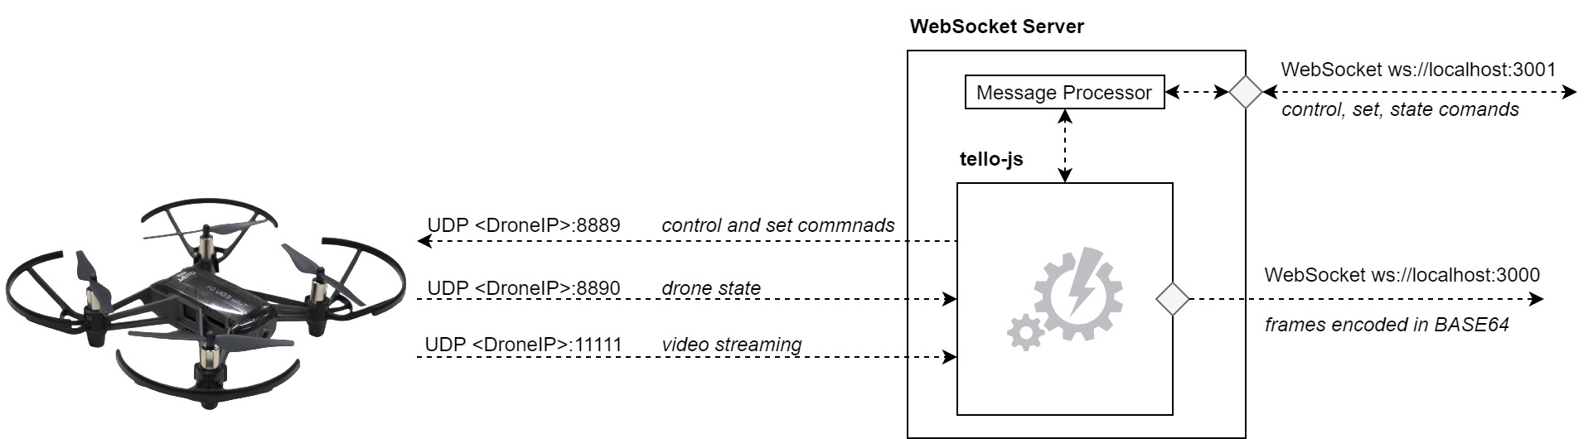

Websocket Server „tello-js“

Slide 17
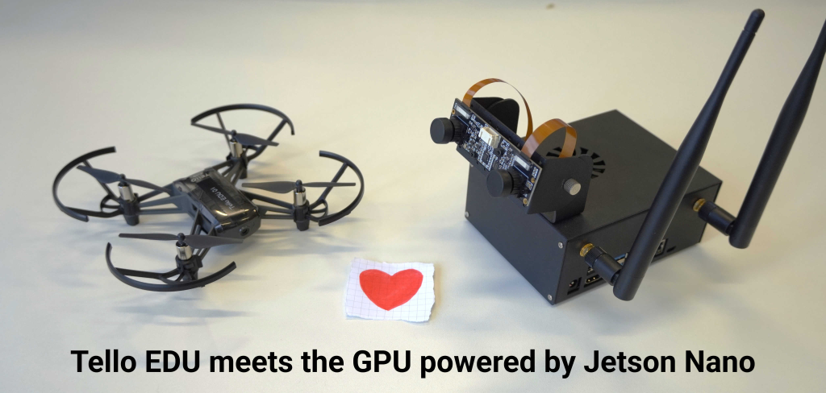
Demonstrations

Slide 18
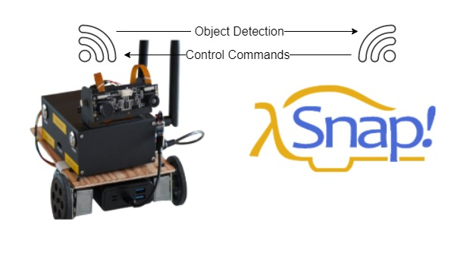
Demonstration 2: Snap! & JetBot (NVIDIA Jetson AI)

Slide 19
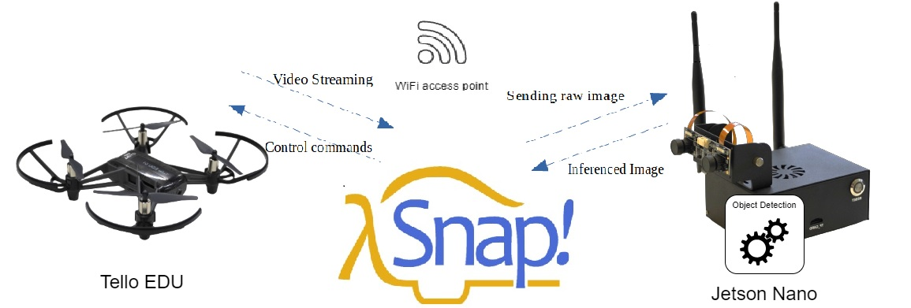
Demonstration 3: Snap! & Tello & Jetson

Slide 20
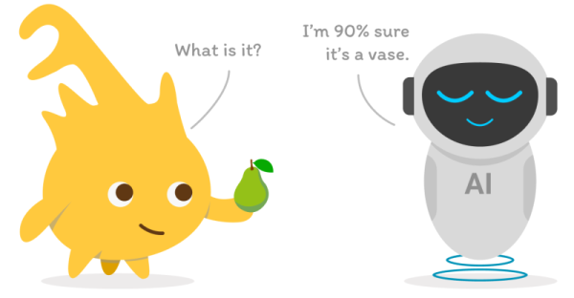
Let‘s plAIy! – Workshop at Snap!Con 2022
https://www.snapcon.org/conferences/2022/program/proposals/512

Slide 21
Workshop Let's plAIy! –
Image Classification in Snap! with NVIDIA Jetson
Rolf Becker | Harley Lara
Ali Farzizada | Ilgar Rasulov | Shreya Gupta
– Rhine-Waal University of Applied Sciences –
hsrw.eu | eolab.de | fablab.green

Slide 22
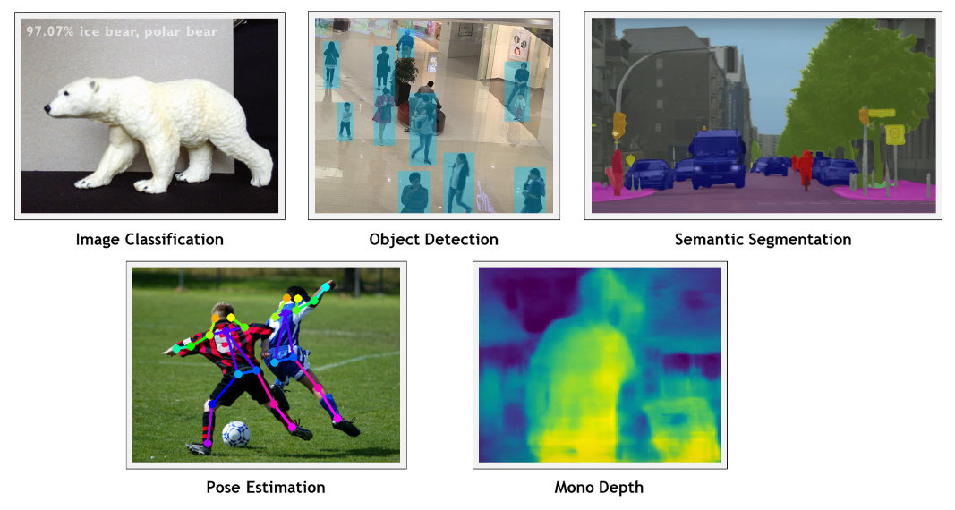
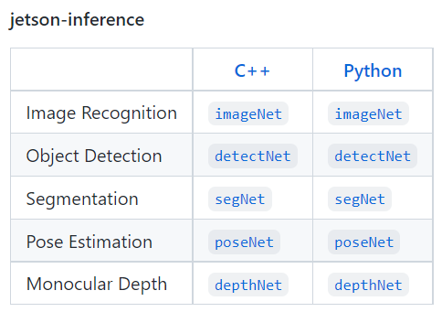
NVIDIA Software Repo „jetson-inference“ (Dustin Franklin)
Dustin Franklin, aka Dusty-NV
https://github.com/dusty-nv/jetson-inference

Slide 23
Image Classification, from NVIDIA Jetson Inference Pkg.
(Default CNN: GoogleNet)
Laptop
NVIDIA Jetson Nano
WebSocket
„classification“
(Python)
Cam
Snap!
ImageNet:
GoogleNet
Stage
frame (base64)
image label
convidence val.

Slide 24
Object Detection, from NVIDIA Jetson Inference Pkg.
(Default CNN: SSD MobileNet V2, COCO, 91 Classes)
Laptop
NVIDIA Jetson Nano
WebSocket
„detection“
(Python)
DetectNet:
SSD MobileNet V2
COCO Dataset
Cam
Snap!
Stage
frame (base64)
List of objects
(JSON) having:
class label
confidence val.
bounding box

Slide 25
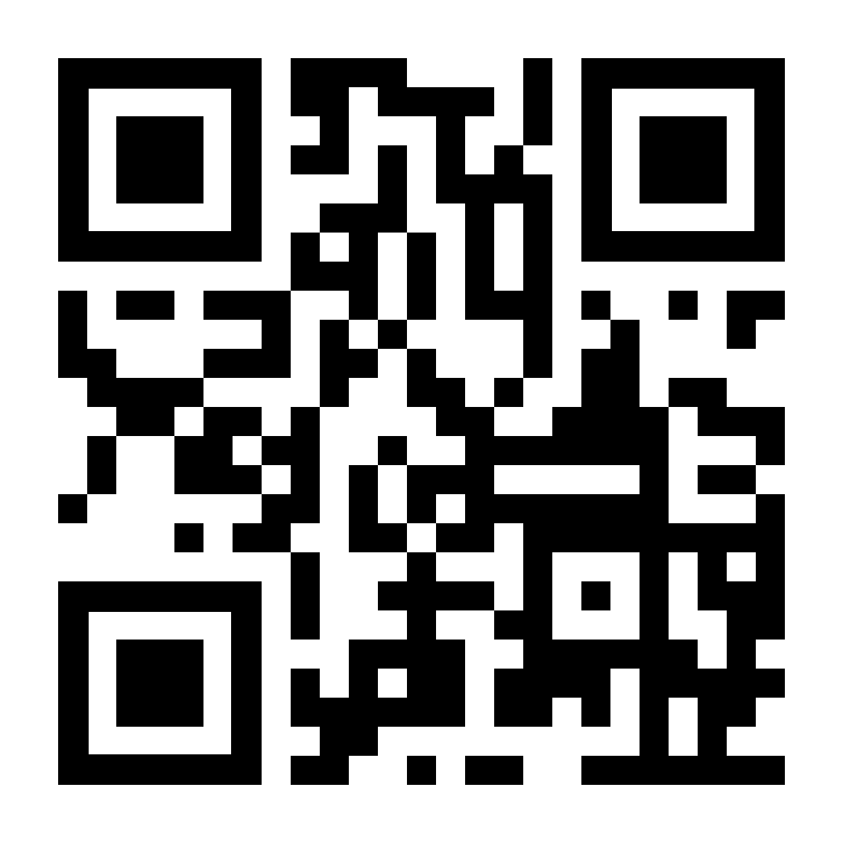
Workshop Manual: snap.eolab.de

